Slide 1
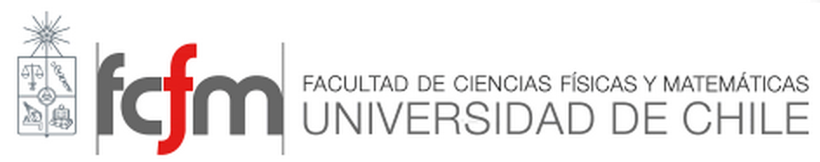

Advanced materials for energy conversion solid cells
Preparation and characterizations of Nanopowders

Slide 2
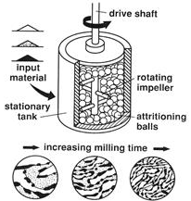
solid-State Reaction
The fabrication procedure affects the product’s microstructure including grain size, grain-boundary width, and porosity.
Different procedures introduce various amounts of impurities to the product.
The first method used to prepare doped ceria is the solid-state reaction which is widely used in synthesizing ceramics due to:
high selectivity
absence of solvents
simplicity.
CeO₂
Gd₂O₃
acetone
Ball-milling (attrition), 150rpm/3h
Drying, 100ºC/24h
planetary ball milling, 270 rpm/30h

Slide 3
chemical synthesis methods
Combustion synthesis
Sonochemical synthesis
Sol-gel process
Co-precipitation Process
…

Slide 4
Combustion synthesis
Novel combustion synthesis processes capable of producing ultrafine powders of oxide ceramics in a surprisingly short time at a lower calcination temperature with improved powder characteristics.
Ce(NO₃)₃.6H₂O
Gd(NO₃)₃.6H₂O
The basic principle of propellant chemistry
Organic Fuels
O/F ≤1.0
Aquous mixing
Cerium Nitrate hexahydrate ( Ce(NO₃)₃.6H₂O)
Mw. 434,22 g/mol
Gadolinium Nitrate hexahydrate ( Gd(NO₃)₃.6H₂O)
Mw.: 451,36 g/mol
Citric acid (C₆O₇H₈)
Mw.: 192,130 g/mol
Combustion 500ºC
Porous foams
Crushing
Ce(+4)
O(-2)
Gd(+3)
N(0)
H(+1)
C(+4)
As-prepared powders
Calcination at 700 ºC
Fully crystalline Ce_{0,9}Gd_{0,1}O_{1,95}
Nanopowders

Slide 5
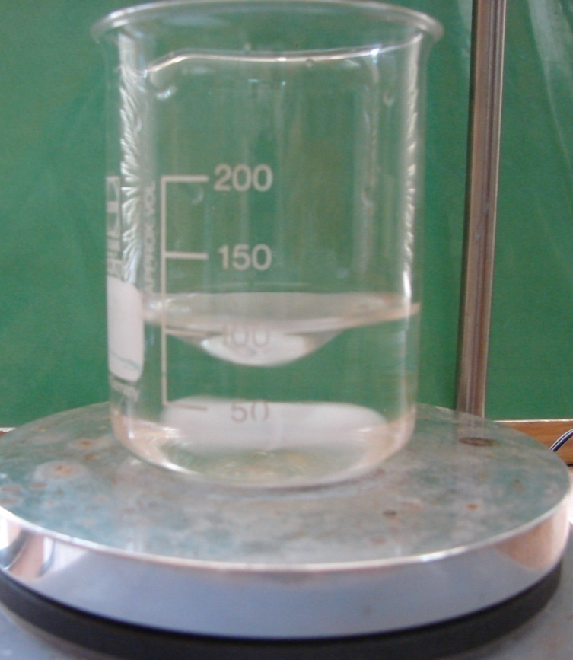
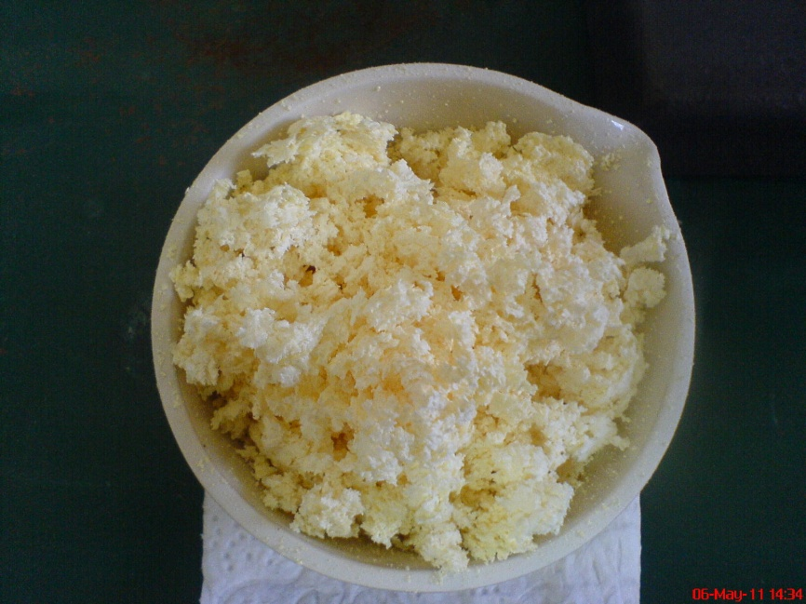
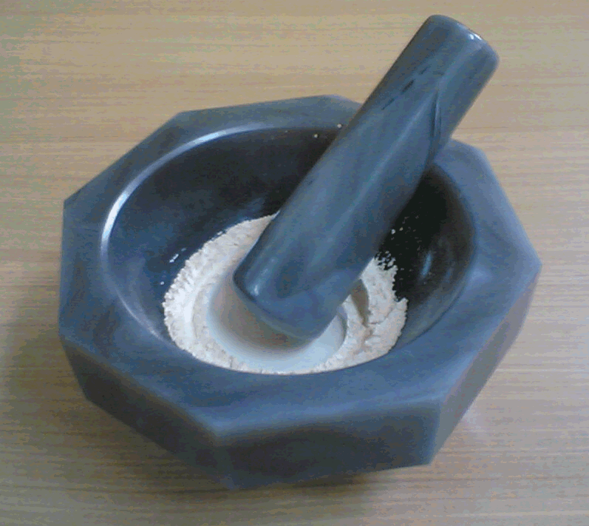
The processing of GDC nanopowder
Self-sustaining combustion method
Cerium Nitrate
Gadolinium Nitrate
10 & 20 mol.%
Organic Fuels
O/F ≤1.0
Aquous mixing
Combustion at 500ºC
Porous foams
Crushing
As-prepared powders
Calcination at 700ºC
Fully crystalline GDC
Nanopowders
Notes:
According to previous Fondecyt project here, combustion synthesis was selected to prepare nanocrystalline GDC powder.
Citric acid was used as an organic fuel and cerium and gadolinium nitrate were used as precursor reagents. As shown in Figure, the general steps are the dissolution of metal nitrates and organic fuels in double distilled water followed by heating at temperatures about 500 ºC for the combustion and porous solid foam was ﬁnally obtained within few minutes. They converted to powder by simple crushing and followed by calcination to obtain Fully crystalline GDC Nano powders
.

Slide 6
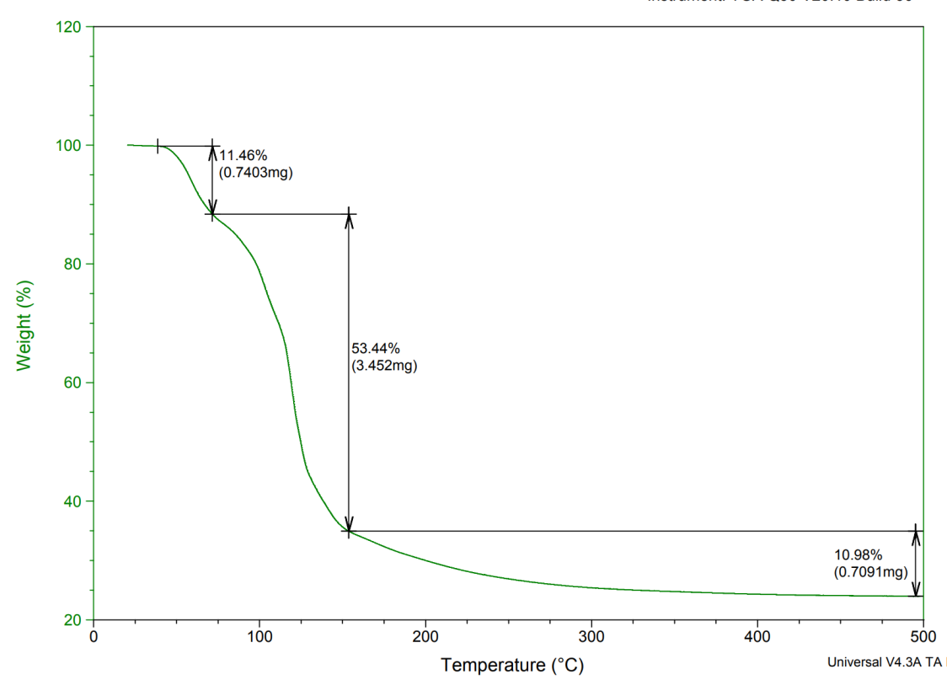
Thermogravimetric Analysis (TGA)
TGA analysis measures the amount of weight change of a material, either as a function of increasing temperature, or isothermally as a function of time, in an atmosphere of nitrogen, helium, air, other gas, or in vacuum.

Slide 7
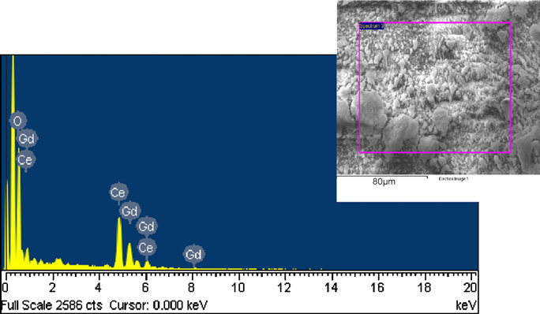
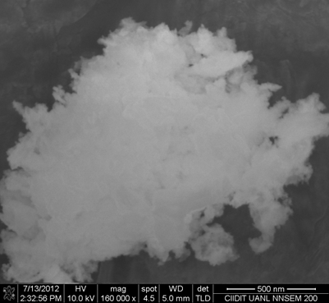
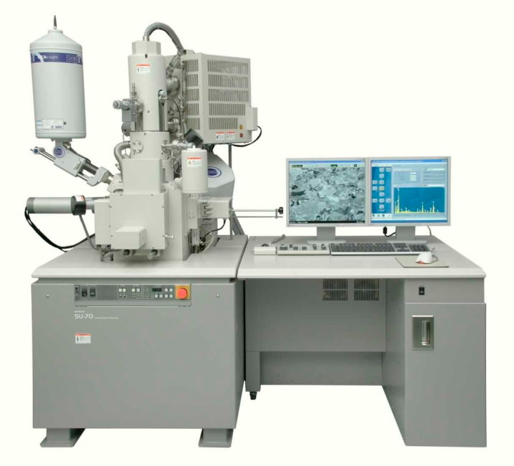
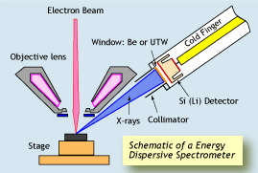
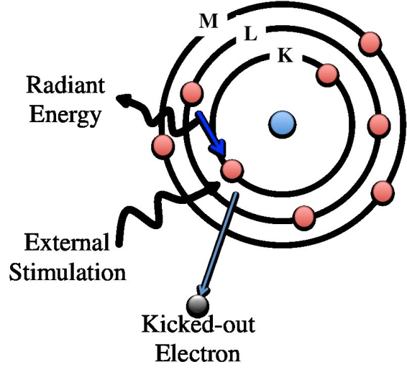
scanning electron microscopy (SEM)
EDS is an analytical technique used for the elemental analysis or chemical characterization of a sample.

Slide 8
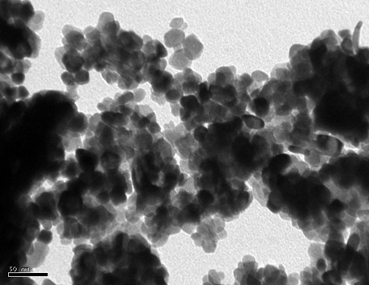
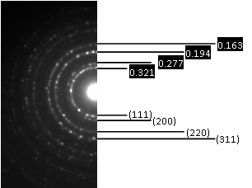
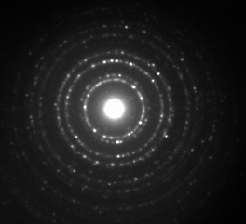
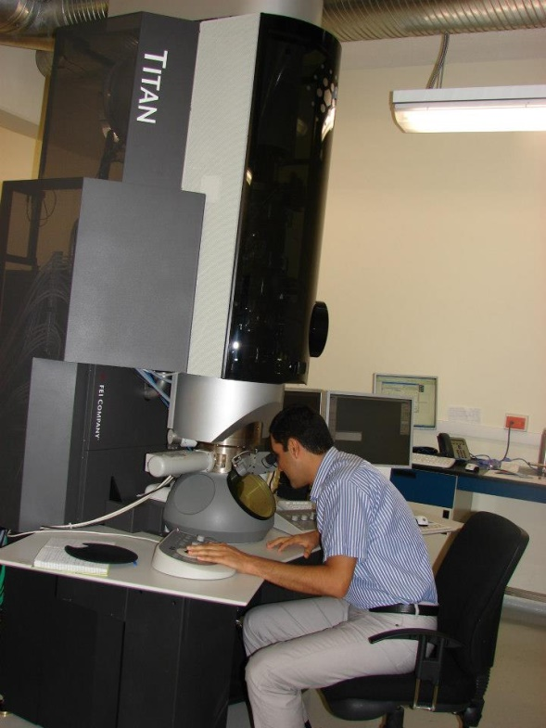
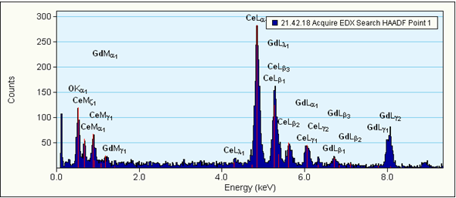
Transmission electron microscopy (TEM)

Slide 9
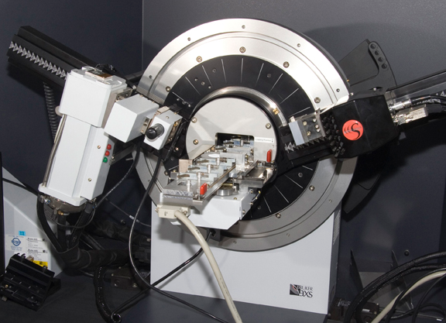
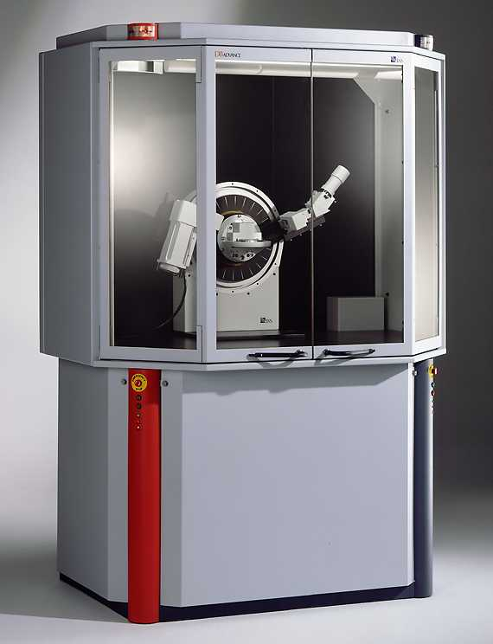
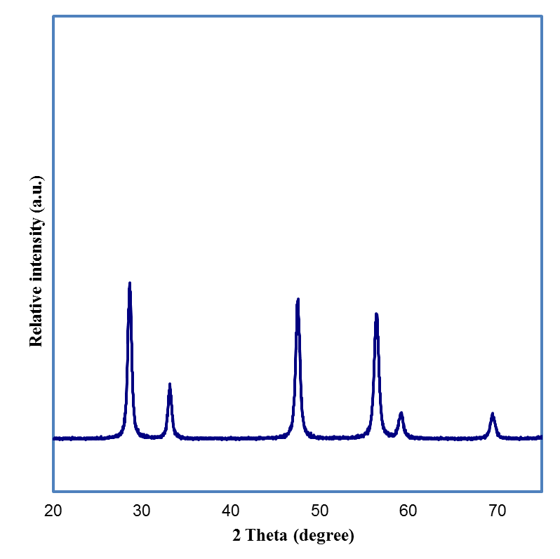
X-ray diffraction (XRD)

Slide 10
What is X-ray?

Slide 11

Production of x-ray
cathode assembly
target layer
e.g. Mo, Rh
anode assembly
(filament)
vacuum
e–
filament
voltage
Cu
e–
HT (–ve)
HT (+ve)
tube window
X-rays
glass envelope

Slide 12
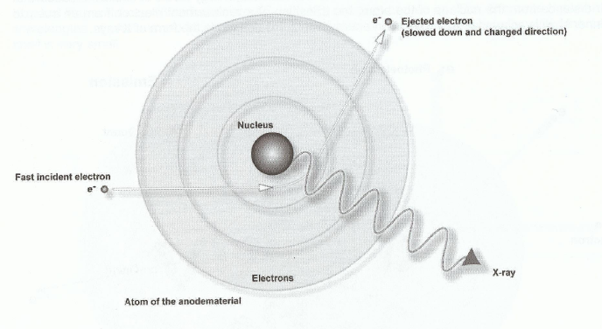
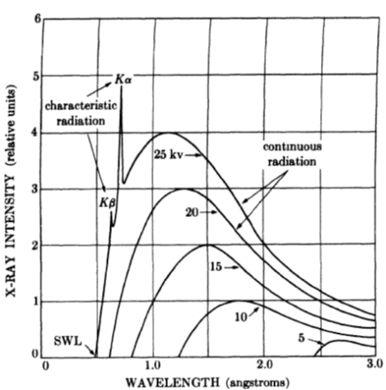
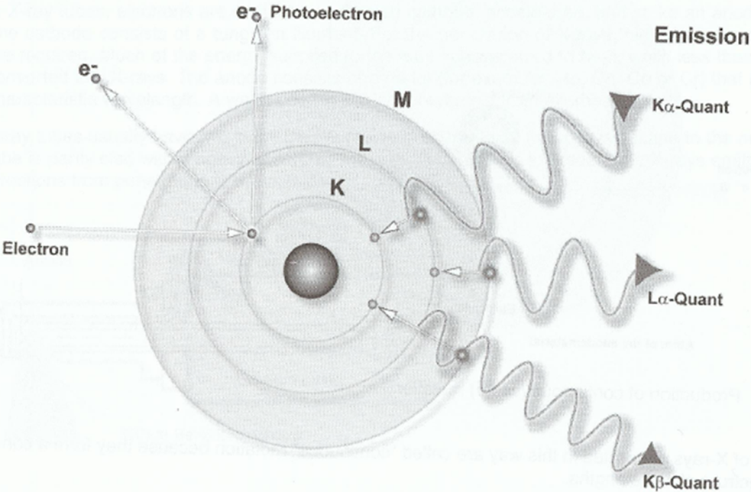
Production of x-ray?
λ_{Cu Kα}: 0.154056 nm

Slide 13
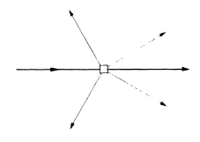
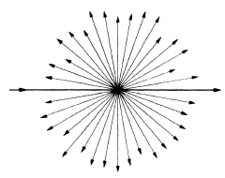
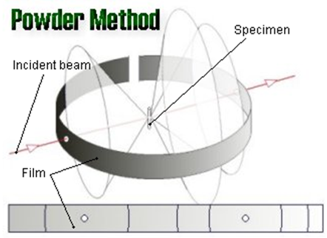

X-ray scattering
X-ray scattering an atom
X-ray diffraction by a crystal

Slide 14
Bragg’s law
nλ = 2d sinθ

Slide 15
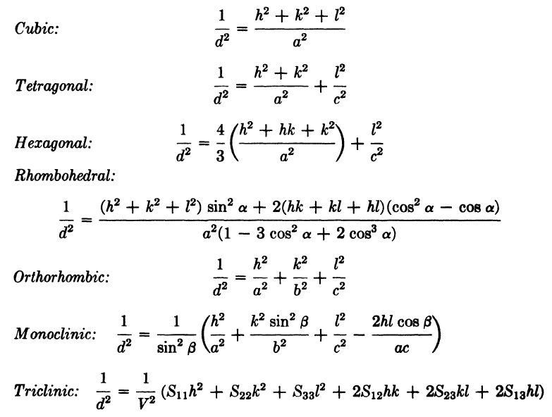
Lattice geometry

