Slide 1
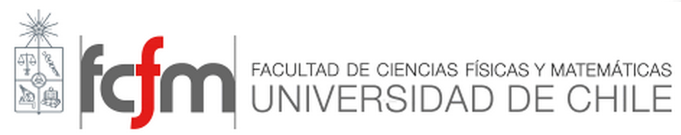

Engineering Materials ІІ
TTT-diagrams

Slide 2
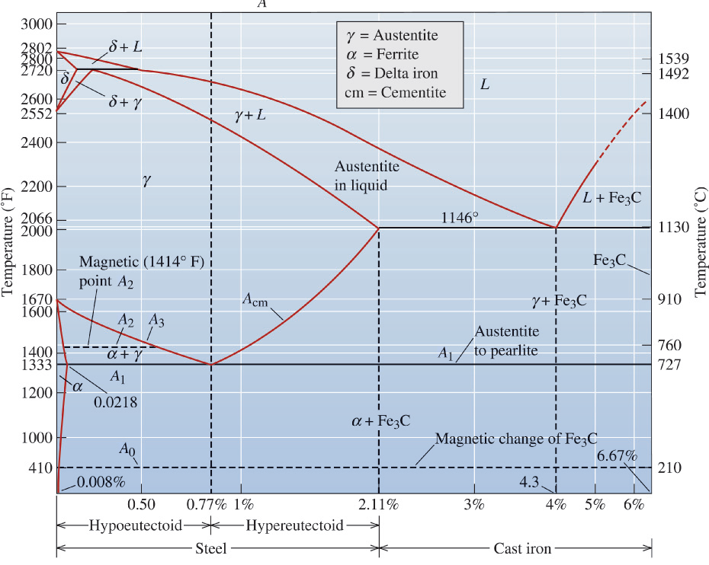
Iron-carbon phase diagram

Slide 3
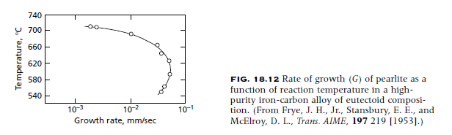
TIME-TEMPERATURE-TRANSFORMATION CURVES

Slide 4
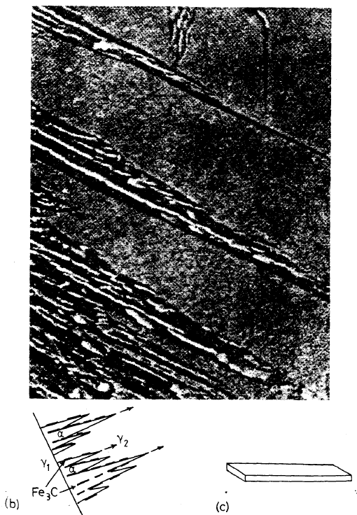
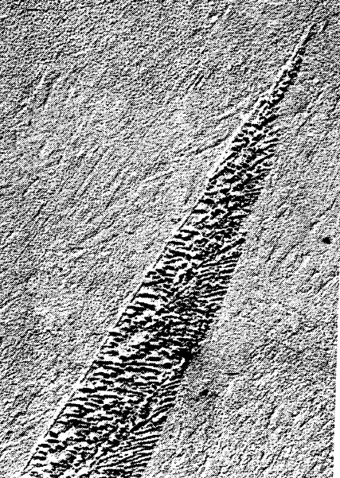
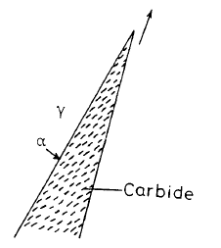
THE BAINITE transformation

Slide 5
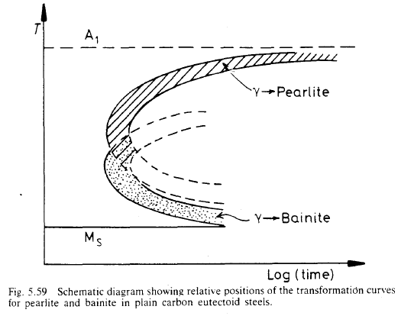
The bainite transformation

Slide 6
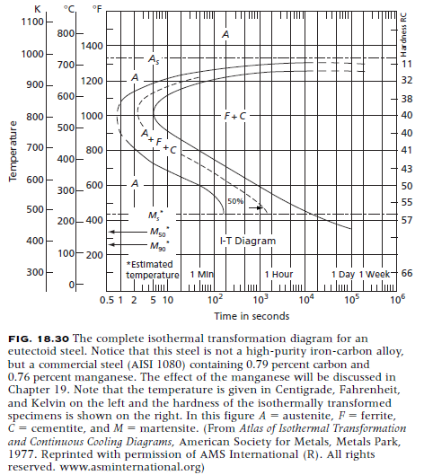
TTT-diagram OF AN EUTECTOID STEEL

Slide 7
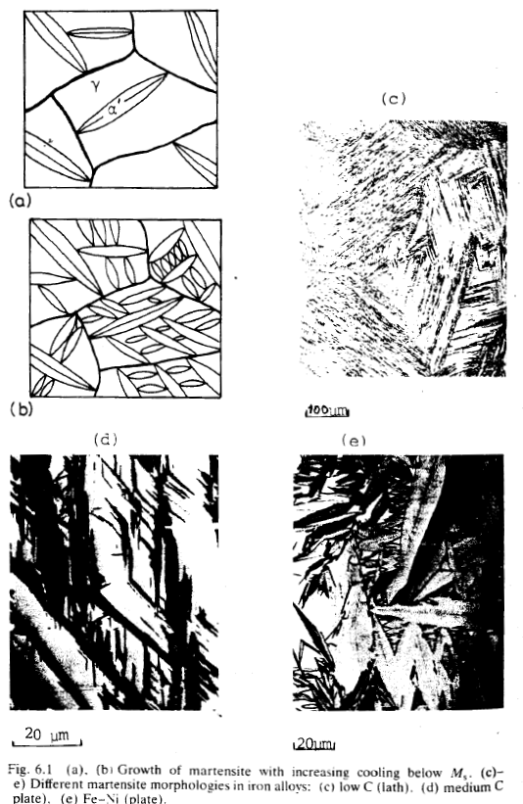
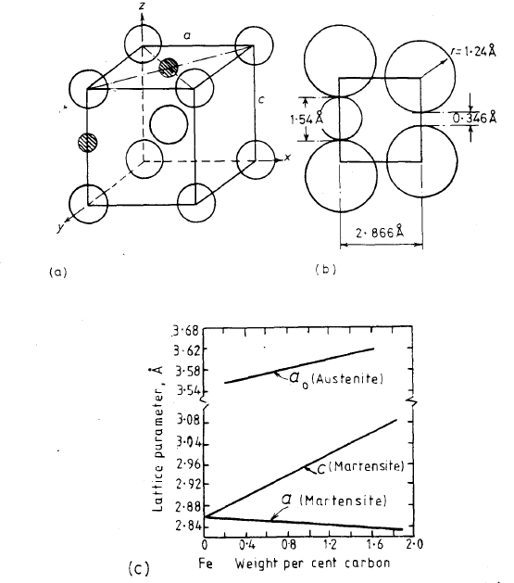
Diffusionless transformation

Slide 8
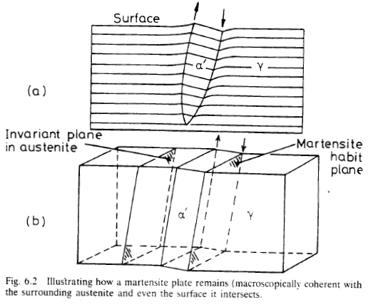
Martensite

Slide 9
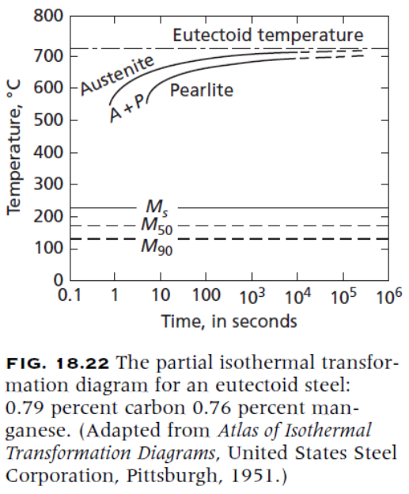
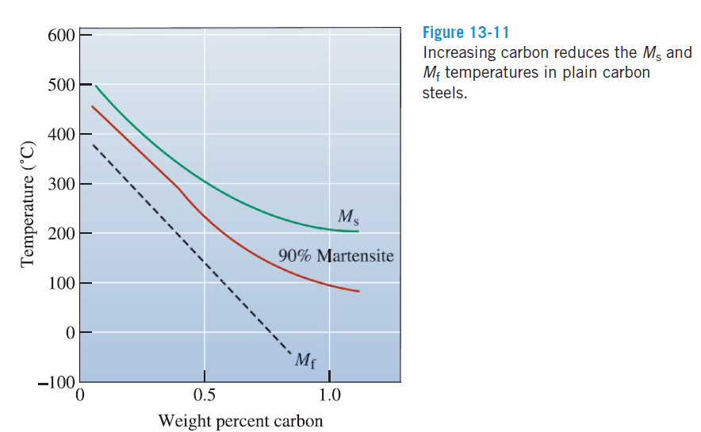
martensite

Slide 10
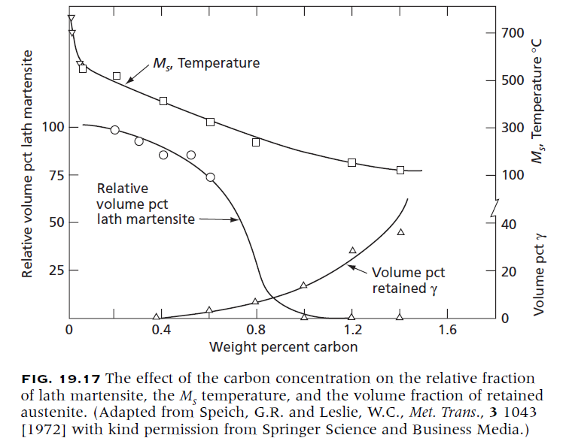
Retained Austenite
A large volume expansion when martensite forms from austenite.
As the martensite plates form during quenching, they surround and isolate small pools of austenite.
for the remaining pools of austenite to transform, the surrounding martensite must deform.
Because the strong martensite resists the transformation, either the existing martensite cracks or the austenite remains trapped in the structure as retained austenite.
Notes:
Listón“: lath

Slide 11
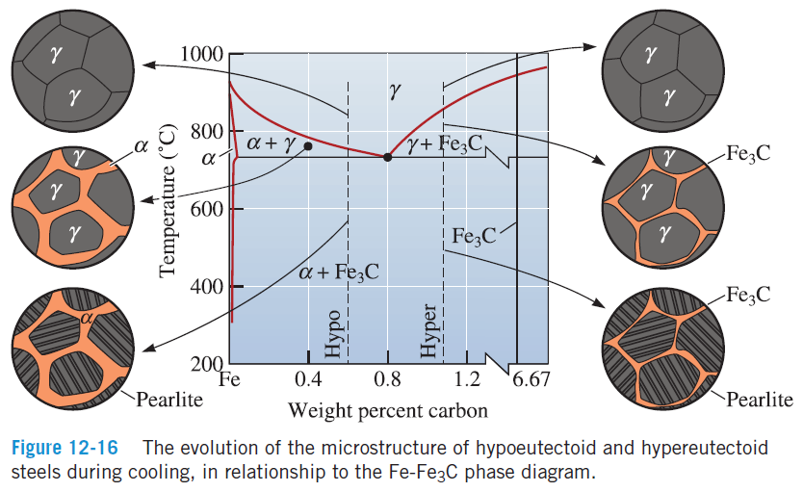
Hypo and hypereutectoid steels

Slide 12
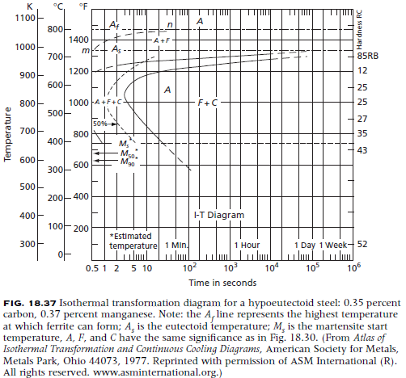
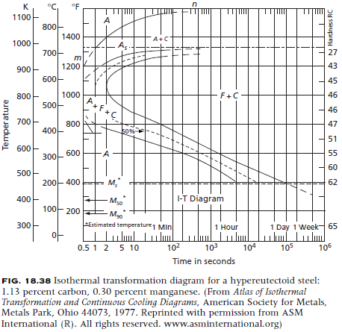
Hypo and hypereutectoid steels

Slide 13
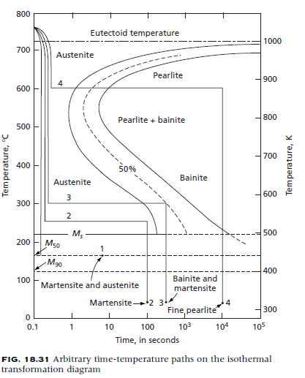
Isothermal heat treatment

Slide 16
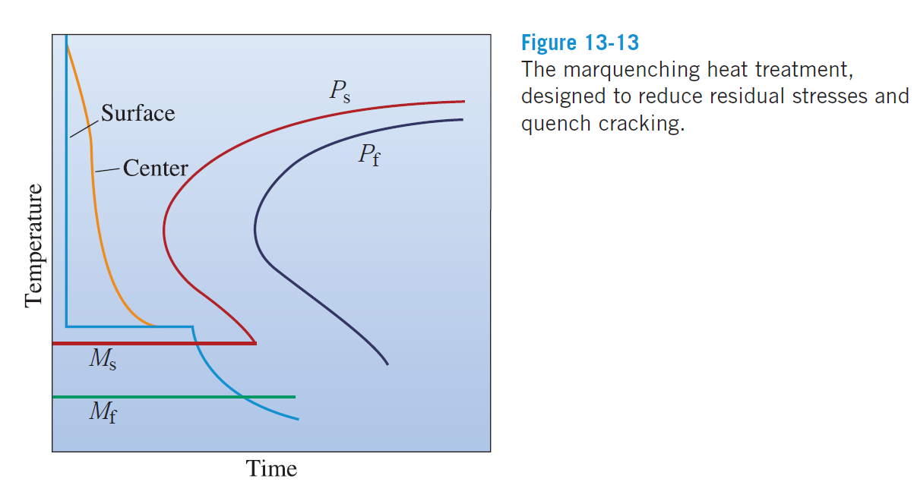
martempering

Slide 17
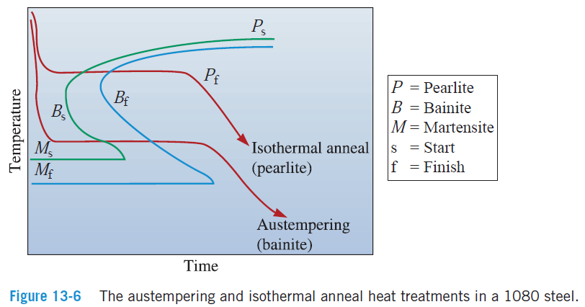
austempering

Slide 18
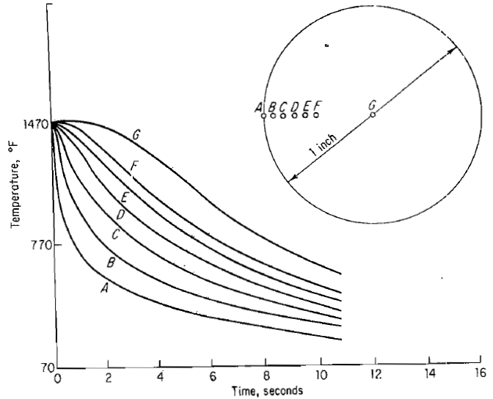

Slide 19
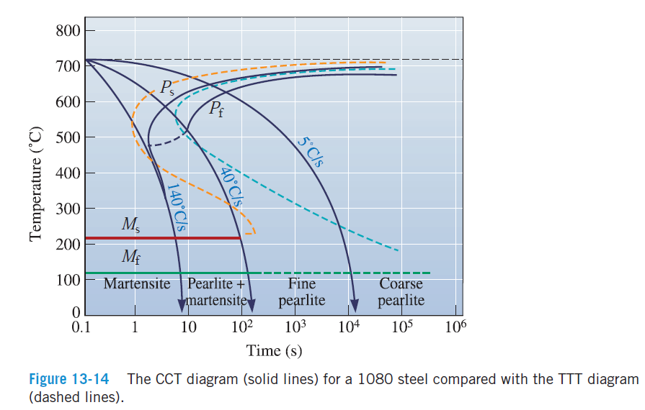
Continuous cooling transformations (CCT)

Slide 20
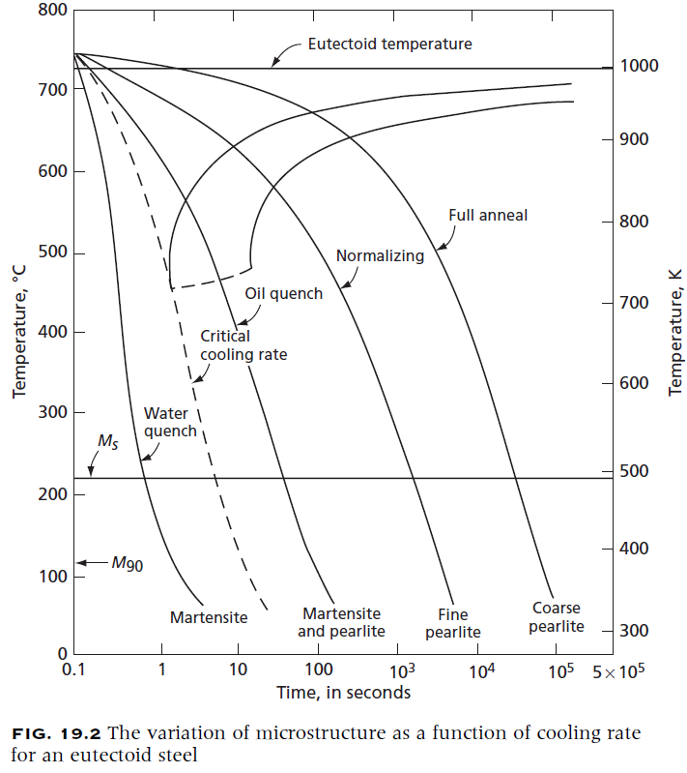
Continuous cooling transformations (CCT)

Slide 21
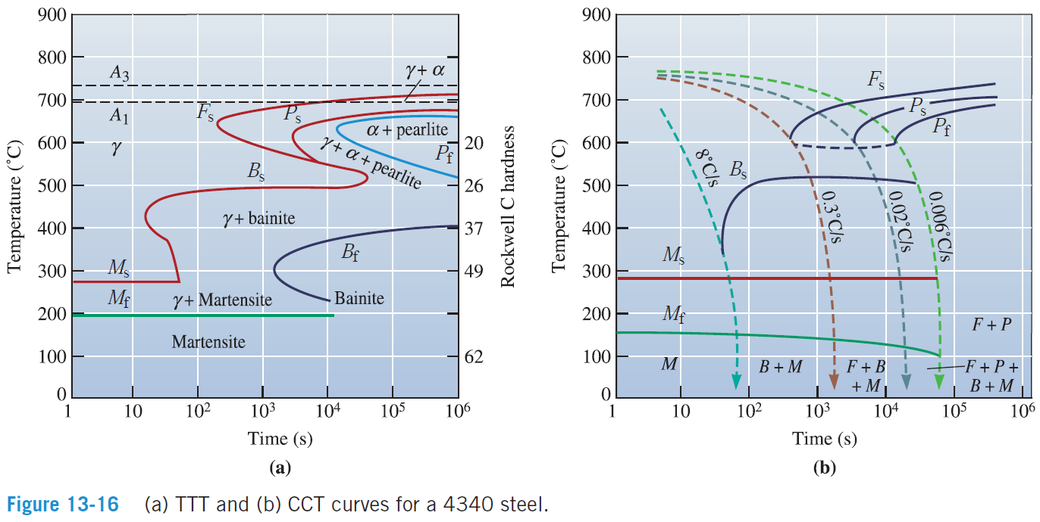
Continuous cooling transformations (CCT)

Slide 22
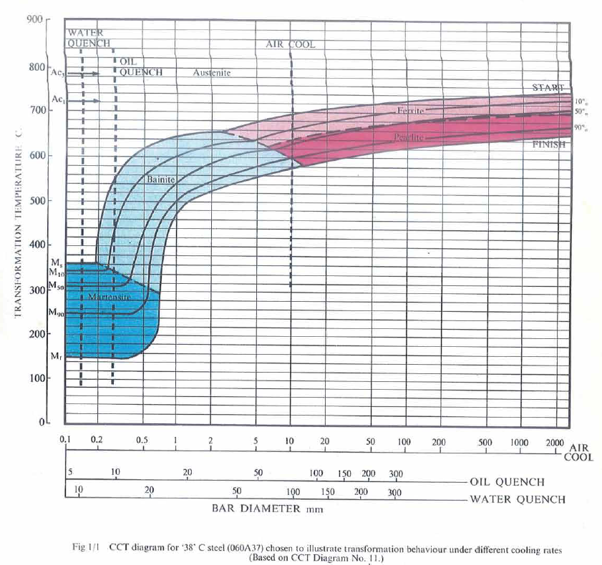
Continuous cooling transformations (CCT)

