Slide 1
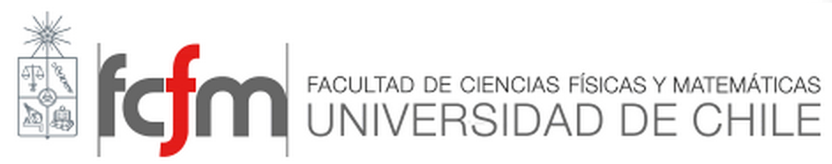

Engineering Materials ІІ
Introduction to Ceramics
Ref. 1 (cap. 17) y Ref. 2 (cap. 15)

Slide 2
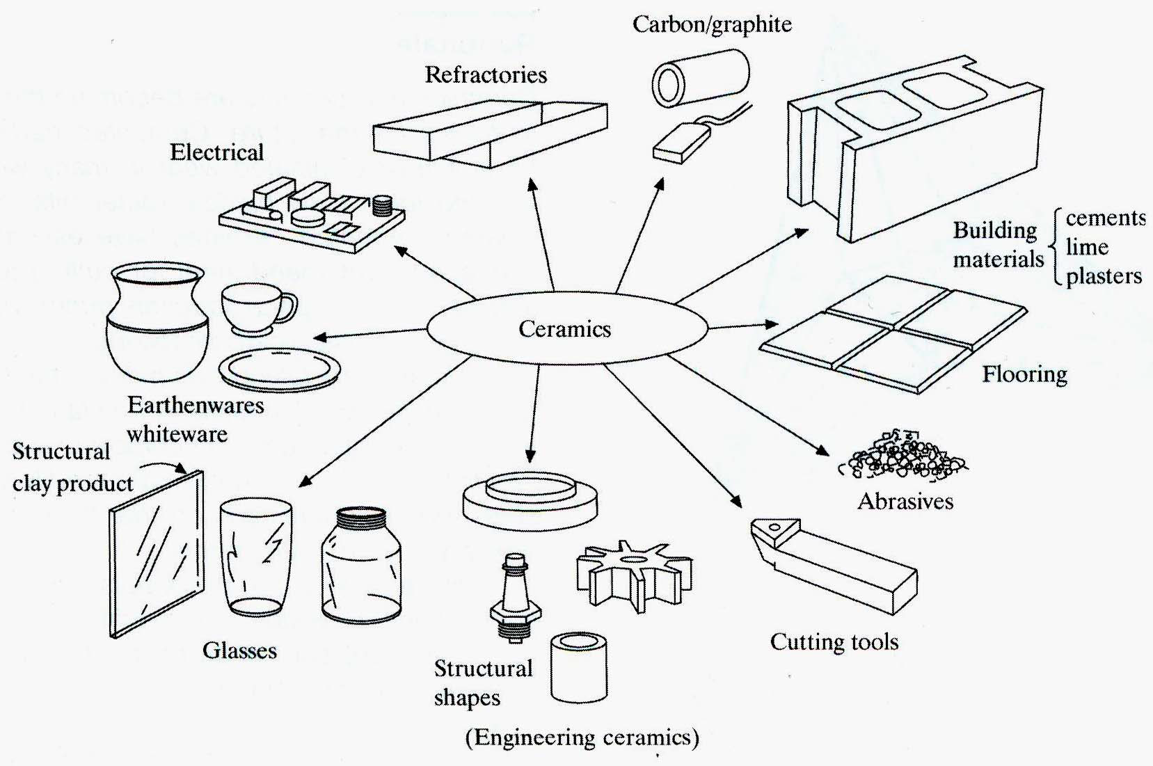
What are ceramics?
Ceramics are inorganic and nonmetallic solids, which have a crystalline or amorphouse structure.

Slide 3
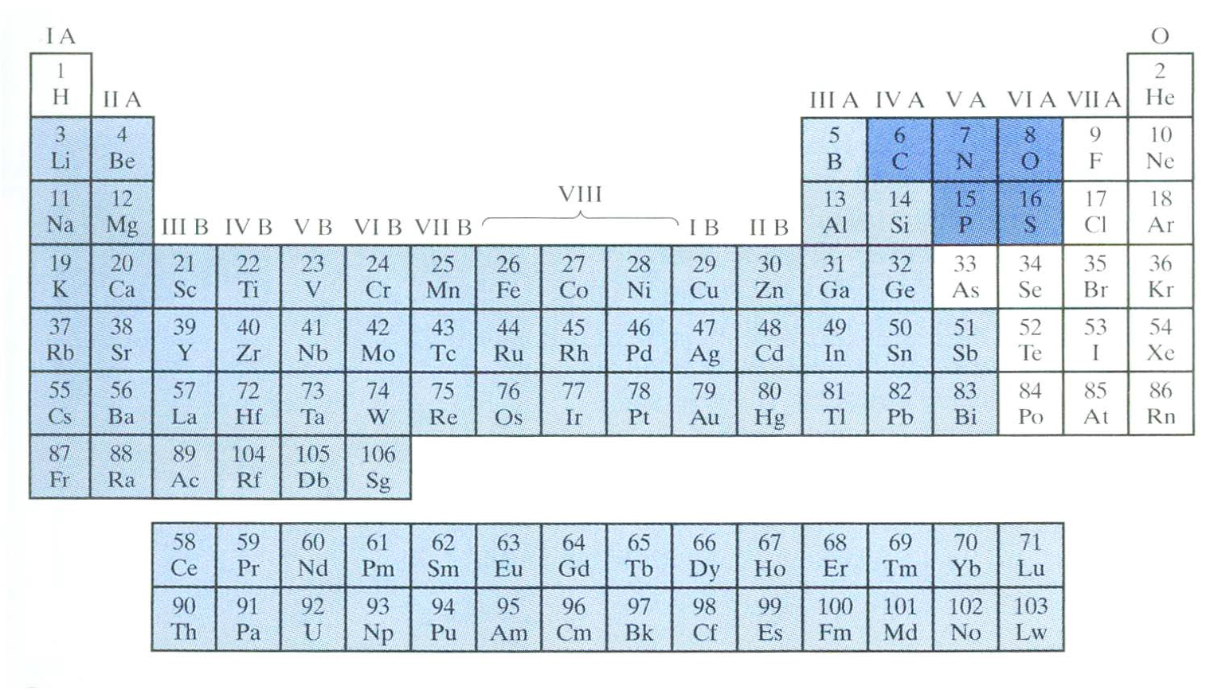
What are ceramics?
Periodic table with ceramics compounds indicated by a combination of one or more metallic elements with one or more nonmetallic elements .
Most of them are compounds of metals with
Oxygen (oxides),Nitrogen (nitrides) and Carbon (carbides).

Slide 4
Generic ceramics
Glasses
Vitreous
Cement & Concrete
Natural Ceramics

Slide 5
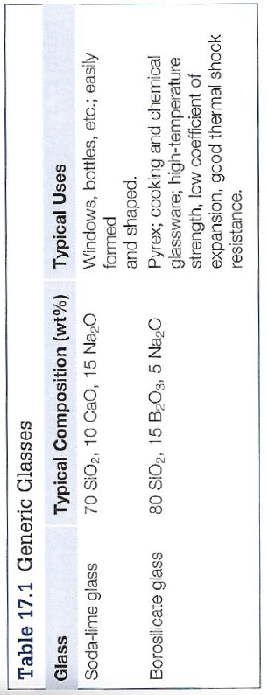


Generic ceramics

Slide 6
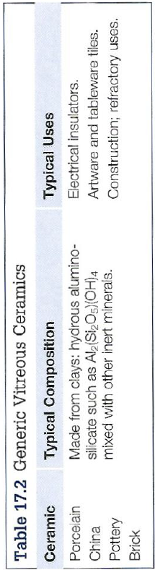
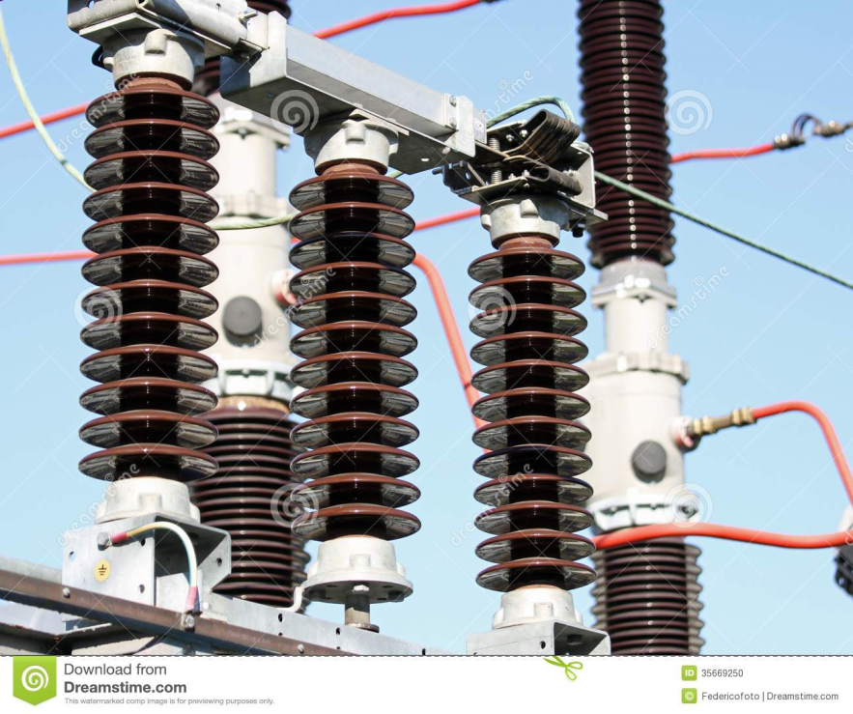

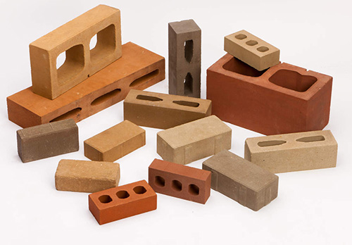
Generic ceramics

Slide 7

Generic ceramics
Cement: combination of lime (CaO), Silica (SiO₂) and Alumina (Al₂O₃)
Concerete: Sand and stones held together by cement

Slide 8
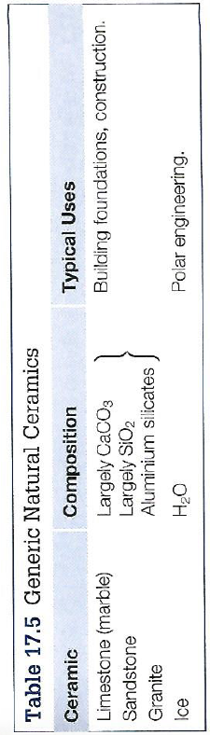




Generic ceramics

Slide 9

Modern ceramics
High Temperature Applications
Wear & Corrosion Resistance
Cutting & Grinding
Electrical Applications

Slide 10

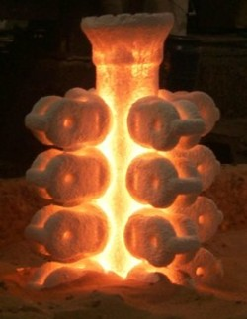
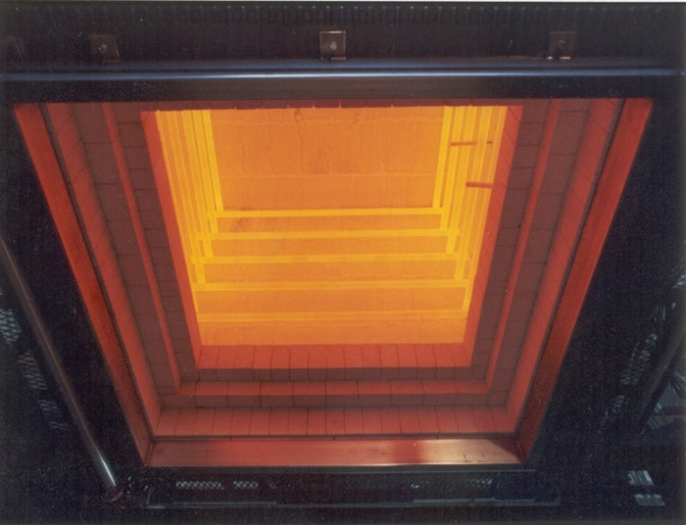
Modern ceramics
High Temperature Applications

Slide 11

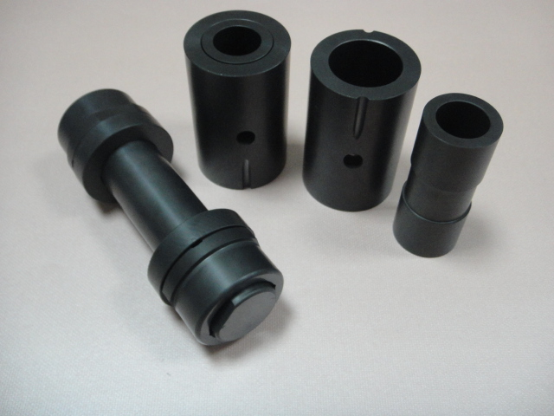
Modern ceramics
Wear & Corrosion Resistance
Silicon Nitride Ceramic Balls
Si3N4
SiC Parts for Magnetic Pump

Slide 12
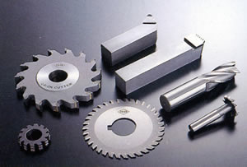
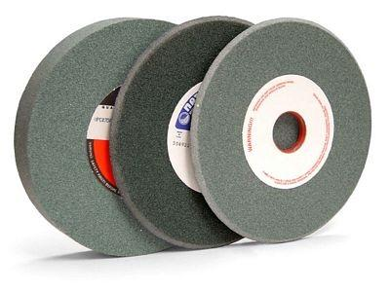
Modern ceramics
Cutting & Grinding
WC-Co Cuitting tools
Silicon Carbide Grinding Wheel

Slide 13
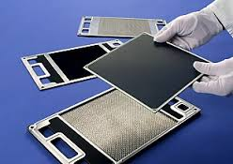

Modern ceramics
Electrical Applications
SOFCs
piezoelectric transducer for energy harvesting.

Slide 14
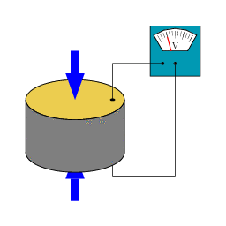
Piezoelectric Effect
Piezoelectric Effect is the ability of certain materials to generate an electric charge in response to applied mechanical stress. The word Piezoelectric is derived from the Greek piezein, which means to squeeze or press, and piezo, which is Greek for “push”.

Slide 15
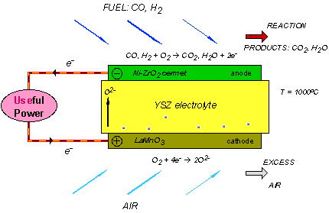
Solid Oxide Fuel Cell (SOFC)
A solid oxide fuel cell (SOFC) is an energy conversion device that produces electricity and heat by electrochemically combining a fuel and an oxidant across an ionic conducting oxide electrolyte.
International Journal of Hydrogen Energy, 35, 2010

Slide 16
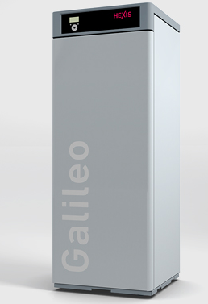
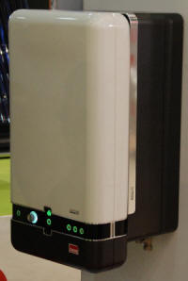
SOFC Applications and Power Systems
Because of their superior electrical efficiency and fuel flexibility, SOFC-based power systems, compared to other fuel cell systems, enable numerous applications at various power levels, from a few-watt to MW size systems.
Small SOFC Systems for Residential CHP Applications
A major application for SOFCs is at 1–5 kW level to supply combined heat and power (CHP) to residential buildings utilizing natural gas as the fuel.
Residential CHP units will probably be the first commercial application of SOFCs.
Notes:
This flexibility allows use of fuels, such as biogas, liquid hydrocarbon fuels, and landfill gas. These fuels can be
reformed to a mixture of hydrogen and carbon monoxide. The direct internal
reforming represents reformation of the fuel directly on the fuel cell anode, thus
electrochemical reaction and fuel reformation simultaneously take place at the
anode. This is a simple and very efficient design with least loss of energy; however,
carbon deposition and temperature inhomogeneity due to endothermic cooling
may present problems in direct internal reforming.
http://www.iii.co.uk/node/112212
http://www.cerespower.com/technology/why-the-steel-cell-is-unique
https://www.youtube.com/watch?v=QfOG6bAuubs
http://www.hexis.com/en/galileo-1000-n

Slide 17
SOFC Applications and Power Systems
Bloom Boxes
100 kW sized SOFC power systems
To commercial customers such as Adobe Systems, Bank of America, Cox Enterprises, Coca Cola Company, eBay, FedEx, Google, Safeway, Staples, Walmart, etc.
Five 100 kW sized SOFC systems (Bloom Boxes) installed at eBay Headquarters
Notes:
to commercial customers such as Adobe Systems, Bank of America, Cox Enterprises, Coca Cola Company, eBay, FedEx, Google, Safeway, Staples, Walmart, etc.

Slide 18
Portable SOFC Power Systems
The portable applications generally require power in the range from milliwatts to a few hundred watts.
Challenges arising for SOFCs in portable applications
stacks must be light
short startup time
thermally sustaining
Advantege
Superior fuel flexibility
Notes:
Microtubular SOFCs have been successfully integrated into portable power
units, primarily by companies such as Adaptive Materials Inc. (USA) and Protonex
Technology Corporation (USA).

Slide 19
SOFC-Based Transportation Auxiliary Power Units (APU)
The challenges for SOFC in APUs
Compact size
Light weight
Short start-up time
Mechanical robustness
Capability for thermal cycling
Delphi’s SOFC APU mounted underneath a Peterbilt’s truck cabin

Slide 20
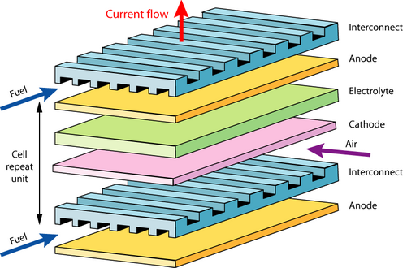
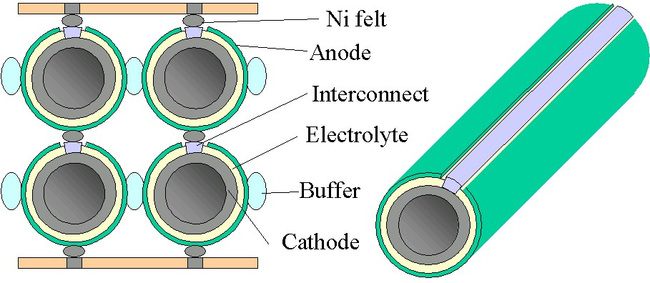
lower cost for the fabrication
SOFC stack
Electrolyte
Anode
Cathode
Interconnects
Sealant
more stable against mechanical
and thermal stresses
Notes:
Under typical operating conditions, a single cell produces less than 1 V. To obtain high voltage and power from the SOFCs, it is necessary to stack many cells Together. this can be done in a number of ways using interconnect materials which are often fabricated into complex shapes to provide for other functions such as air and fuel channelling and sealing.
1152-cell 100 kW SOFC power system began operation near Arnhem in the Netherlands in January 1998.
Tubular cells are more stable against mechanical and thermal stresses than
planar cells. But modern technologies (tape casting, screen printing, vapour
deposition. plasma spraying, wet spraying and others) promise lower cost for the fabrication of planar cells.

Slide 21
SOFCs Advantege
High-energy conversion efficiency
Less pollution
Low noise or acoustical pollution
Effective reduction of greenhouse gas (CO₂)
Process simplicity
Generating excessive heat

Slide 22
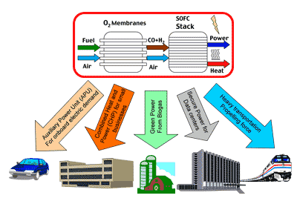
Potential areas of application
S. C. Singhal and K. Kendall, High Temperature Solid Oxide Fuel Cells, Elsevier Ltd, 2003

Slide 23
Disadvantage
The costs of fuel cells are still considerably higher than conventional power plants per kW.
High working temperature
Long start-up time
Material costs
high cost of the balance-of-plant (BOP) parts
Research objective:
Decreasing the operation temperature

Slide 24
Electrolyte
Requirements
High ionic conductivity
Neglegible electronic conductivity
Gas-tightness
Chemical stability in reducing & oxidizing atmosphere
Mechanical stability
Economic aspects
International Journal of Hydrogen Energy, 35, 2010

Slide 25
Anode
Requirements
Good chemical and thermal stability during
fuel cell fabrication and operation.
High electronic conductivity under fuel cell
operating conditions.
Excellent catalytic activity toward the oxidation
of fuels.
Manageable mismatch in coefficient of thermal
expansion (CTE) with adjacent cell components.
sufficient mechanical strength and flexibility.
Tolerance to carbon deposition, sulfur poisoning, and reoxidation.
Low cost.

Slide 26
Cathode
Requirements
high electrical conductivity
high catalytic activity for oxygen reduction
compatibility with other cell components

Slide 27
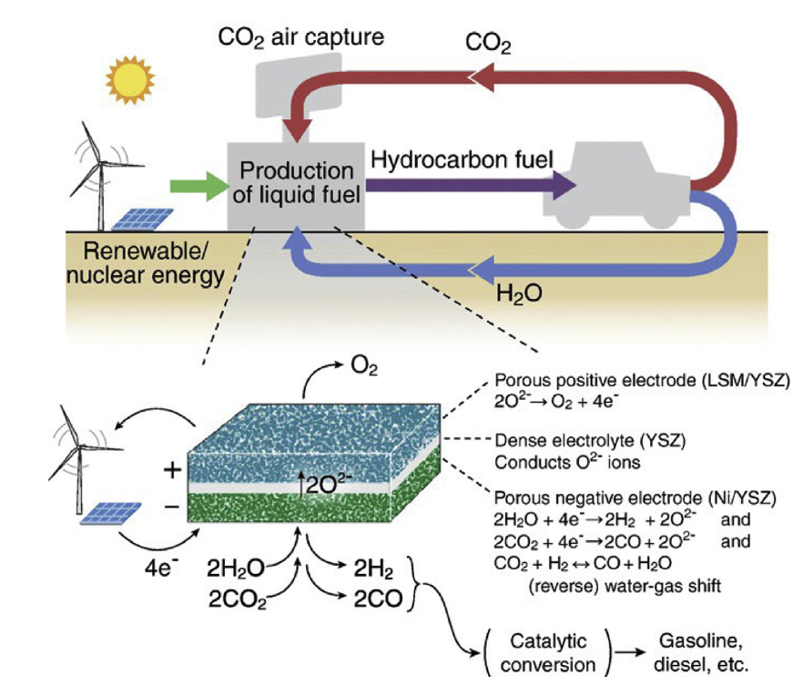
Solid oxide electrolizar cells (SOEC)

