Slide 1
Sublime Women and the Supernatural
Threat in Edgar Allan Poe’s
“Berenice”, “Ligeia”, and “Morella”
Examen para optar al grado de Licenciado en Lengua y Literatura Inglesas
XXXXX XXXXX XXXXX
XXXXX XXXXX XXXXX
Prof. Pablo San Martín

Slide 2
Edgar Allan Poe’s “Berenice”, “Morella” and “Ligeia”
Aesthetic theory
Stylistic analysis
Gender studies
How did we become interested in this research topic?
“[The] close personal relationship between femininity, love, and death makes Poe’s work fall into “the realm of the sublime” (148), as the aesthetic experiences that are enhanced are the death and loss of a beautiful woman and the emotional excess of the bereaved lover, transforming the ladies into an “emotional catalyst for her partner” (Weekes 148). (p.6)
Weekes, Karen. “Poe’s Feminine Ideal.” The Cambridge Companion to Edgar Allan Poe. Ed. Kevin J Hayes. Cambridge: Cambridge UP, 2002. 148–162. Print.

Slide 3
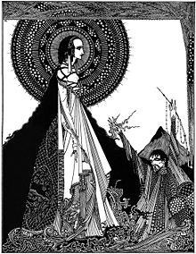
Main thesis
In the Dark Ladies’ tales, there is a process where the women are depicted as sublime objects by their narrators, where subsequently they are deprived of their corporeality and humanity: as their beauty and intelligence are highlighted and divinized, their bodies are fragmented, becoming strange and ambiguous. These qualities transform the women into a threat to the narrators as they are something the men cannot control in the story, a threat that terrifies the narrators and readers alike.
"Ligeia" by Harry Clarke (1919)

Slide 4
Beauty and
the Sublime
On the Sublime:
“Whatever is fitted in any sort to excite the ideas of pain, and danger, that is to say, whatever is in any sort terrible, or is conversant about terrible objects, or operates in a manner analogous to terror, is a source of the sublime; that is, it is productive of the strongest emotion which the mind is capable of feeling” (Burke 36, emphasis added)
“In this case the mind is so entirely filled with its object, that it cannot entertain any other, nor by consequence reason on that object which employs it” (Burke 53).
On Beauty:
Beauty in a holistic perspective
“By beauty I mean, that quality or those qualities in bodies by which they cause love, or some passion similar to it” (Burke 83, emphasis added).
Burke, Edmund. A Philosophical Enquiry into the Origin of Our Ideas of the Sublime and Beautiful. Ed. Adam Phillips. Oxford: Oxford UP, 1998. Print.

Slide 5
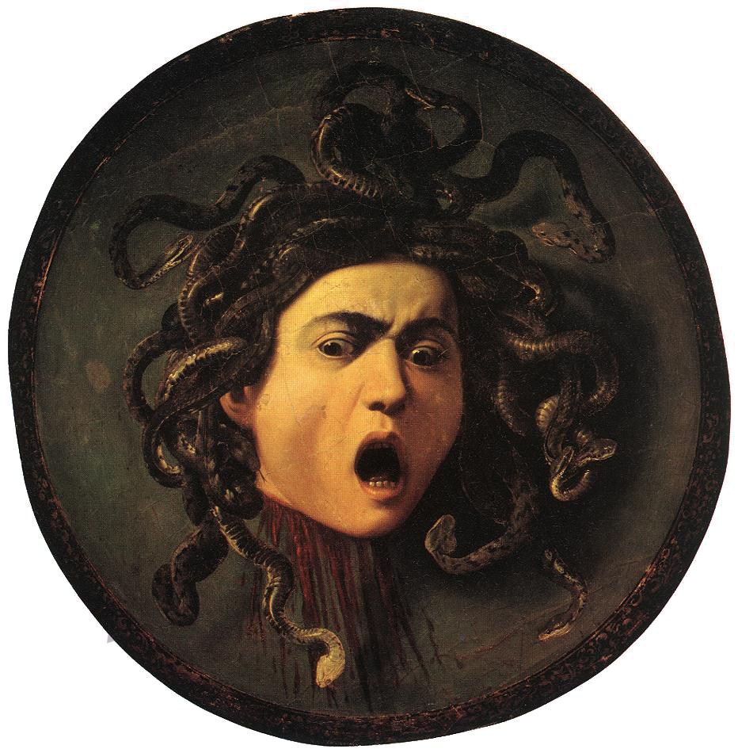
Mario Praz’s “The Beauty of the Medusa”
Fear and love
Bridge between Beauty and the Sublime
“Medusa” by Caravaggio (1597)
Praz, Mario. “The Beauty of the Medusa”. The Romantic Agony. Trans. Angus Davidson. London: Oxford UP, 1951. 25-50. Print.

Slide 6
Feminine Beauty as Sublime
As the ladies are presented as sublime objects for the narrators, their descriptions objectify and transform them into ethereal entities, resulting in a paradoxical loss of their corporeality.

Slide 7
Feminine Beauty as Sublime
“The forehead was high and very pale, and singularly placid; and the once jetty hair fell partially over it, and overshadowed the hollow temples with innumerable ringlets, now of a vivid yellow, and jarring discordantly, in their fantastic character, with the reigning melancholy of the countenance” (“Berenice” 102, emphasis added)
“the lofty and pale forehead”, “the raven-black naturally-curling tresses”, “the skin rivalling the purest ivory” (“Ligeia” 112)
“thrilling and enthralling eloquence of her low, musical language” (“Ligeia” 111, emphasis added)
Morella: “musical language” that also resembles “an oppressing spell” (106).

Slide 8
II. Knowledge as Power and Threatening Women
While the narrators start the characterization of the ladies by highlighting their otherworldly beauty, it is in the ladies’ occult intellect and underlying assertiveness that further fascinates the men. However, these qualities become threatening for the narrators because it gives the ladies superiority over them, something that goes against the passiveness that the men want to impose on the women.

Slide 9
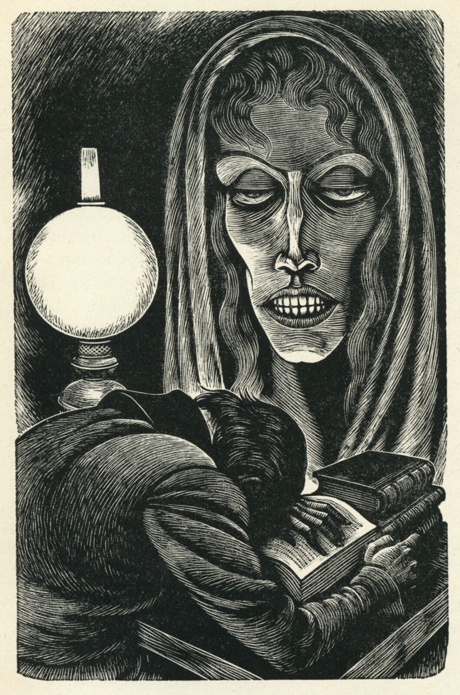
II. Knowledge as Power and Threatening Women
In “Ligeia” and “Morella”, knowledge represents the authority that the ladies have on their lovers.
Berenice’s smile: dangerous message (“peculiar meaning”)
“Berenice” (1944), illustrated by Fritz Eichenberg

Slide 10
III. Fragmentation and the Spectral Body
Finally, the fragmentation of the ladies and their recognition as a strange, threatening element to the narrators result in the ladies’ spectralization, because they become ambiguous, dehumanized and incorporeal entities, set apart from their male lovers.

Slide 11
III. Fragmentation and the Spectral Body
“Neither fully present nor fully absent, material nor immaterial, the specter not only troubles the stability of the subject but renders categories of identity . . . uncertain and undecidable” (Munford 121).
“Owing to its cultural associations with the territories of irrationality, otherness and corporeal excess, femininity has been particularly and peculiarly susceptible to ‘spectralisation’” (Munford 120).
Munford, Rebecca. “Spectral Femininity”. Women and the Gothic: An Edinburgh Companion. Eds. Avril Horner and Sue Zlosnik. Edinburgh: Edinburgh UP. 120-134. Print.

Slide 12
Final reflections
The importance of our research topic
Working collaboratively
How did our analysis evolve while researching?
Our perception of the tales
The importance of the Sublime in the tales
Future research ideas

Slide 13
Thank you so much for your attention!

