Slide 1
9° Ayudantía
Capitulum Quintum:
Villa et Hortus
Latín I – Prof. Constanza Martínez
Andrew Mayne-Nicholls Merino
a.maynenicholls@ug.uchile.cl
«In vinō veritas, in aquā sanitas»

Slide 2
INDEX
Pequeño Repaso
Execritia 8 – 11
Pensa A, B, C
Kahoot!

Slide 3
A. Repaso

Slide 4
Preposiciones que exigen abalativo
De momento hemos visto:
+ In
+ Ex
+ Ab
+ Sine
+ Cum
  S

Slide 5

*Todo esto en está presente, falta mucho para que veamos otros tiempos verbales.
modo Imperativo y Modo Indicativo
[Modo Indicativo] | I Conj. |  | II Conj. |  | III Conj. |  | IV Conj.
 | S | P | S | P | S | P | S | P
1era pers.
2da pers.
3ra pers. | - at | - ant | - et | - ent | - It / | - unt / | - it | - iunt
[Modo Imperativo] | I Conj. |  | II Conj. |  | III Conj. |  | IV Conj.
 | S | P | S | P | S | P | S | P
2da persona | - ā | - āte | - ē | - ēte | - e / | - ite / | - ī | - īte

Slide 6
Tabla de Is, Ea, Id
 | Masc. |  | Fem. |  | Neu.
 | S | P | S | P | S | P
Nominativo | Is | IĪ | Ea | Eae | Id | Ea
Genitivo | Eius | Eōrum | Eius | Eārum | Eius | Eōrum
Acusativo | Eum | Eōs | Eam | Eās | Id | Ea
Ablativo | Eō | Iīs | Eā | Iīs | Eō | Iīs
Dativo

Slide 7
Tabla de 1era y 2da declinación
 | Masc. (2°) |  | Fem. (1°) |  | Neu. (2°)
 | S | P | S | P | S | P
Nominativo | - us / -r | - ī | - a | - ae | - um | - a
Genitivo | - ī | - ōrum | - ae | - ārum | - ī | - ōrum
Acusativo | - um | - ōs | - am | - ās | - um | - a
Ablativo | - ō | - īs | - ā | - īs | - ō | - īs
Dativo
Vocativo | - *e / - r | - ī | - a | - ae | - um | - a

Slide 8
Ejercicios

Slide 9
B. Exercitia…
Hagamos los Exercitia 8 - 11

Slide 10
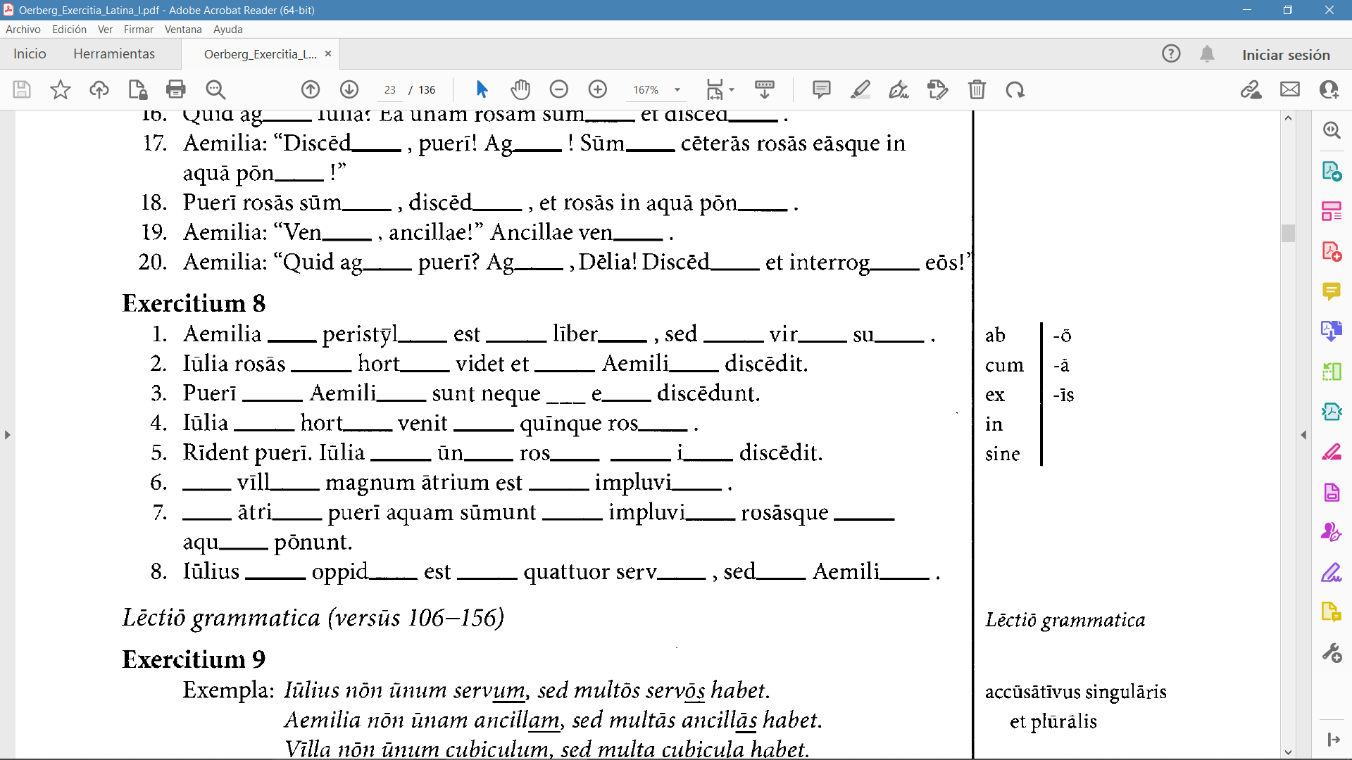

Slide 11
in
ō
cum
īs
sine
ō
ō
in
ō
ab
ā
cum
ā
ab
ā
ex
ō
cum
īs
cum
ā
ā
ab
īs
In
ā
cum
ō
In
ō
ex
ō
in
ā
in
ō
cum
īs
sine
ā

Slide 12
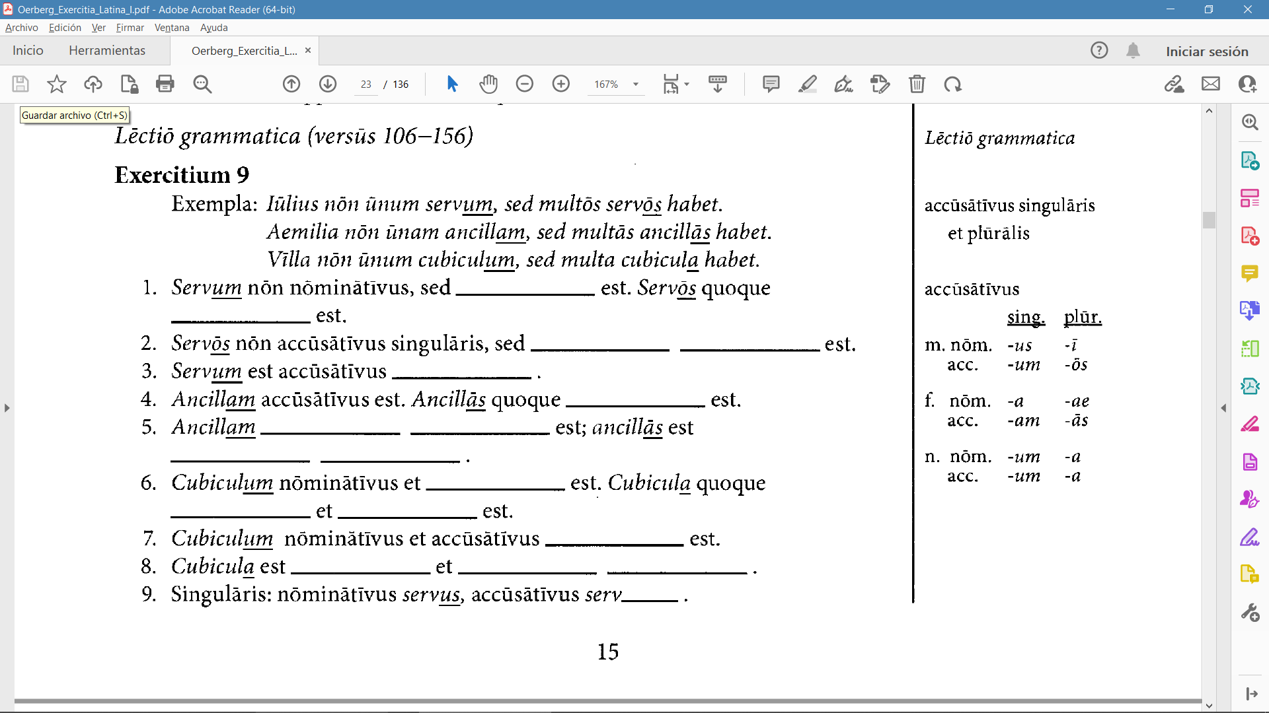
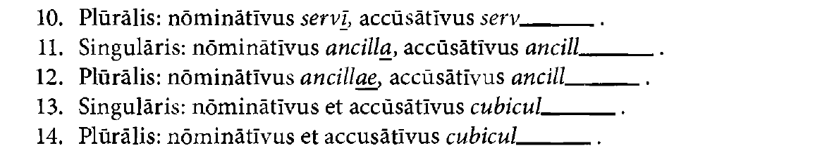

Slide 13
accūsātīvus
accūsātīvus
accūsātīvus
plūrālis
singulāris
accūsātīvus
accūsātīvus
singulāris
accūsātīvus
plūrālis
accūsātīvus
nōminātīvus
accūsātīvus
singulāris
nōminātīvus
accūsātīvus
plūrālis
um
ōs
am
ās
um
a

Slide 14
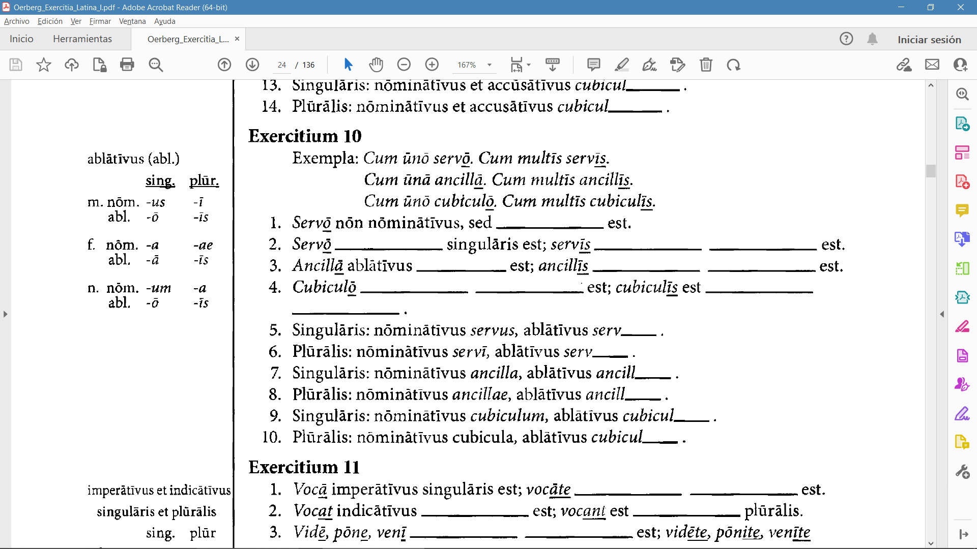

Slide 15
ablātīvus
ablātīvus
ablātīvus
plūrālis
singulāris
ablātīvus
plūrālis
ablātīvus
singulāris
ablātīvus
plūrālis
ō
īs
ā
īs
ō
īs

Slide 16
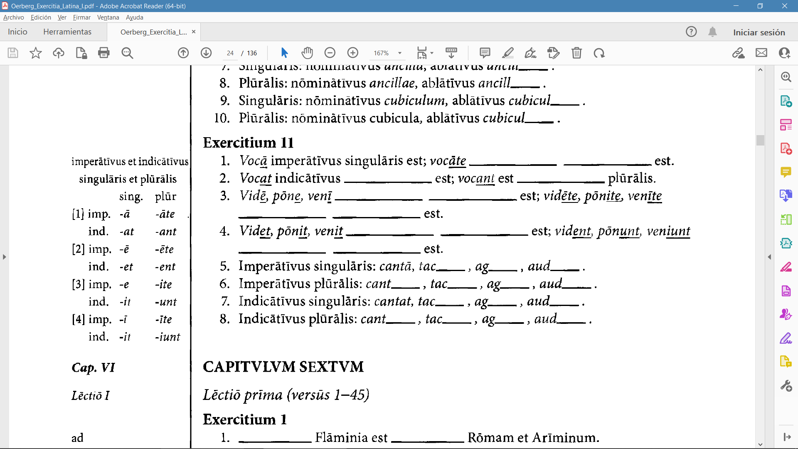
Saturn is composed of hydrogen and helium

Slide 17
imperātīvus
plūrālis
singulāris
indicātīvus
imperātīvus
singulāris
imperātīvus
plūrālis
Saturn is composed of hydrogen and helium
indicātīvus
singulāris
indicātīvus
plūrālis
ē
e
ī
āte
ēte
ite
īte
et
it
it
ant
ent
unt
iunt

Slide 18
C. Pensa…
Hagamos los Pensa A, B y C

Slide 19
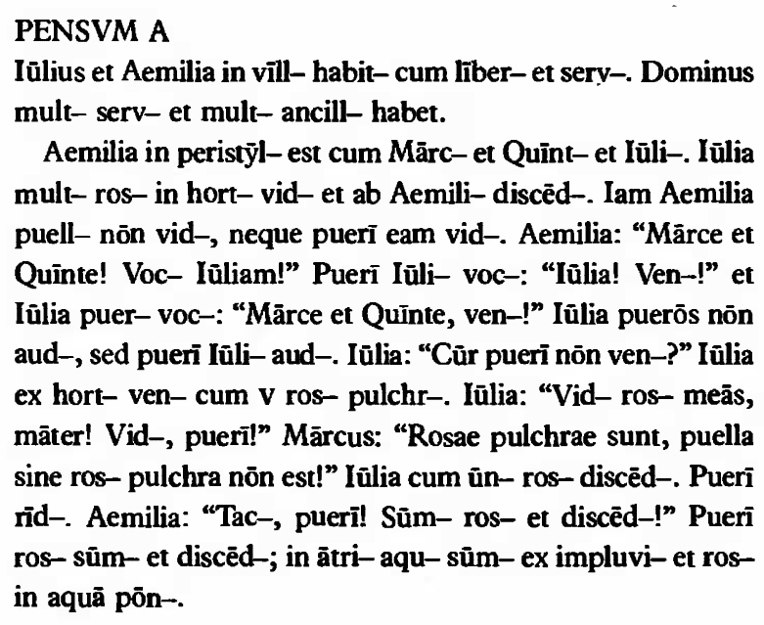
Saturn is composed of hydrogen and helium

Slide 20
ā
ant
īs
īs
ōs
ōs
ās
ās
ō
ō
ō
ā
ās
ās
ō
et
ā
it
am
et
ent
āte
am
ant
ī
ōs
at
īte
Saturn is composed of hydrogen and helium
it
am
iunt
iunt
ō
it
īs
īs
ē
ās
ēte
īs
ā
ā
it
ent
ēte
ite
ās
ite
ās
unt
unt
ō
ā
unt
ō
ās
unt

Slide 21
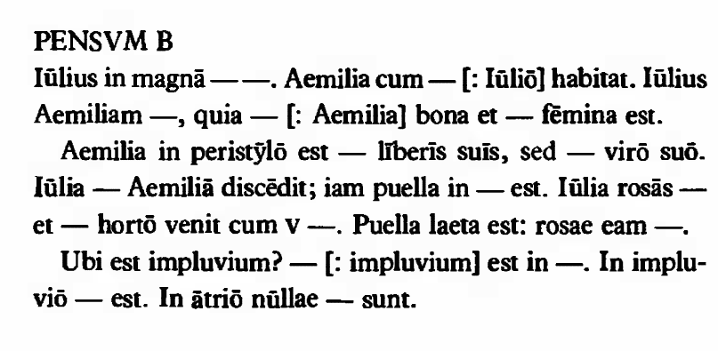
Saturn is composed of hydrogen and helium

Slide 22
villā
habitat
eō
amat
ea
pulchra
cum
sine
ab
hortō
carpit
Saturn is composed of hydrogen and helium
dēlectant
ex
rosīs
Id
ātriō
aqua
fenestrae

Slide 23
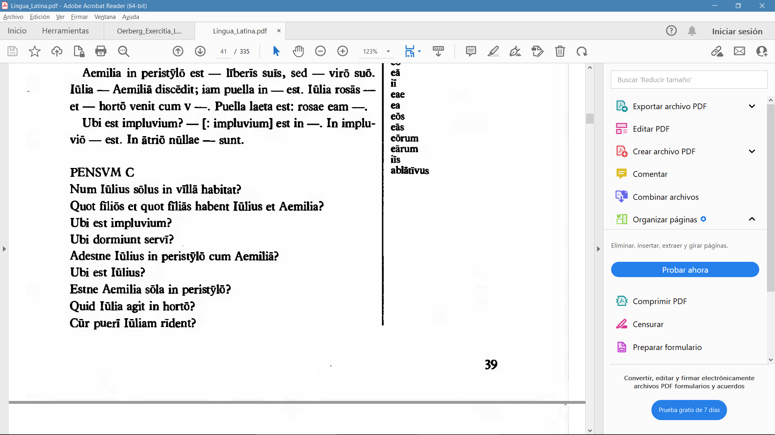

Slide 24
PENSUM C
Iūlius nōn sōlus, sed cum familiā suā Iūlius habitat.
Iī habent duōs fīliōs et unam fīliam.
Impluvium est in ātriō.
Servī dormiunt in par̄vō cubiculō.
Iūlius nōn adest, sed abest.
Iūlius in oppidō est, cum quattuor servīs.
Aemilia nōn sōla, sed cum liberīs suīs est.
Iūlia rosās carpit.
Puerī rīdent Iūliam quia iī improbī sunt.

Slide 25
D. Kahoot!

Slide 26
¡Gracias!

