Slide 1
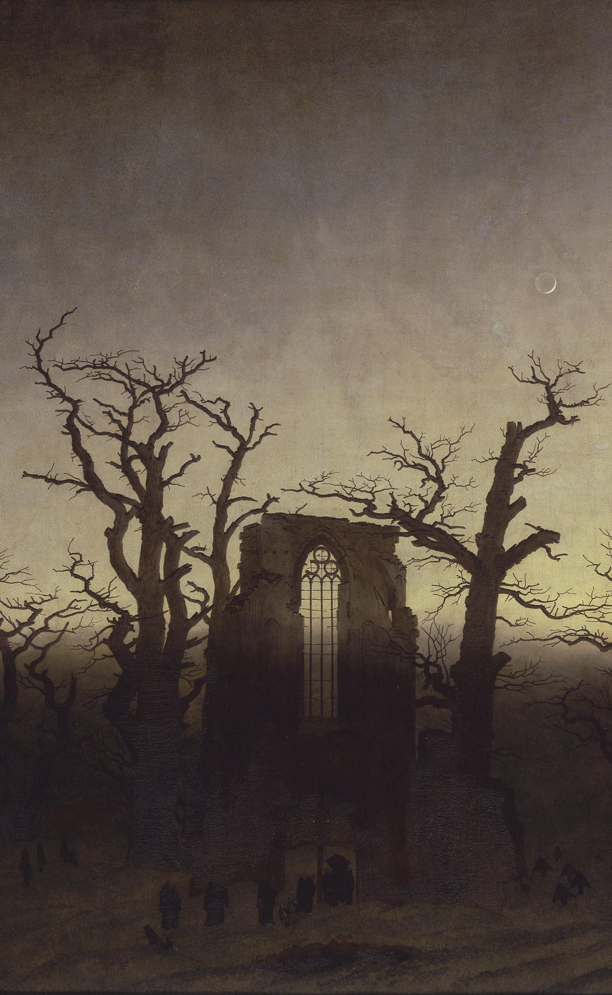
The Gothic in English-Speaking Fiction: Terror, Horror, and Other Aesthetic Forms of Fear
Pablo San Martín
pablosanmartin@uchile.cl

Slide 2
Overview
Reading List
Methodology
Assessment
Introductory Activity

Slide 3
Reading List
Literary Texts
Aesthetic Theory
The Castle of Otranto
Vathek
The Romance of the Forest
Frankenstein
Carmilla
‘The Yellow Wallpaper’ and other short stories
The Sublime: Edmund Burke
The Grotesque: Edwards and Graulund
Terror and Horror: Ann Radcliffe
Technophobia: Daniel Dinello
The Uncanny: Sigmund Freud
The Female Gothic: Ellen Ledoux

Slide 4
Reading List
‘The illustrious poets also, annoyed by the platitude of prose, speedily relinquished their uncongenial task.’
Mary Shelley, Introduction to the 1831 edition of Frankenstein.
In 18C and early 19C, fiction was regarded as a minor genre and gendered female (in both its authorship and readership).
During the romantic period, the novel acquires greater cultural reputation and its gender dynamics changes.

Slide 5
Reading List
Margree, Victoria. British Women’s Short Supernatural Fiction, 1860-1930: Our Own Ghostliness. London: Palgrave, 2019.
Charlotte Riddell (1832-1906)
Mary Elizabeth Braddon (1835-1915)
Edith Nesbit (1858-1924)
Alice Perrin (1867-1934)
Violet Hunt (1862-1942)
Eleanor Scott (1892-1965)

Slide 6
Methodology
Core Units
Research Project
Week 1
Reading Journal
Presentations on the literary text
Debate in the comments section
Week 2
Presentation on theory
Debate in the comments section
Topic Proposal
Annotated Bibliography
Overview or Introduction Draft
Critical Essay

Slide 7
Assessment
Participation: 10%
Reading Journal: 20%
Presentation on a Literary Text: 15%
Presentation on Theory: 15%
Critical Essay: 40%

Slide 8
Reading Journal
What is it?
A record of what you experience while reading a literary text.
3 entries of 100-150 words per text.
Learning Outcomes
Delve into your own aesthetic experience.
Sharpen your perceptiveness to the formal peculiarities of literary texts.
Recall your initial reactions to inform your critical writing at later stages.

Slide 9
Presentations
Literary Text
Aesthetic Category
Personal reading of one important aspect of the text
Arguments supported by the analysis and interpretation of passages (quotations)
Critically engage with 2 relevant pieces of criticism
Question(s) for debate
Clear explanation of the main concepts and how they are presented by the author (summary or diagram)
Examples of how the concepts could be applied
Critical assessment of their usefulness to interpret literary texts

Slide 10
Critical Essay
Final result of a Research Project with progressive submissions.
Stages: Topic Proposal, Annotated Bibliography, Outline or Draft Introduction and Critical Essay
Research Training: Finding Sources, Using Literary Criticism, Writing Plan
Requirements: 2,000 words, personal reading of a topic, aspect or issue covered in the seminar, compare two literary works and aptly engage with at least 4 relevant pieces of criticism.

Slide 11
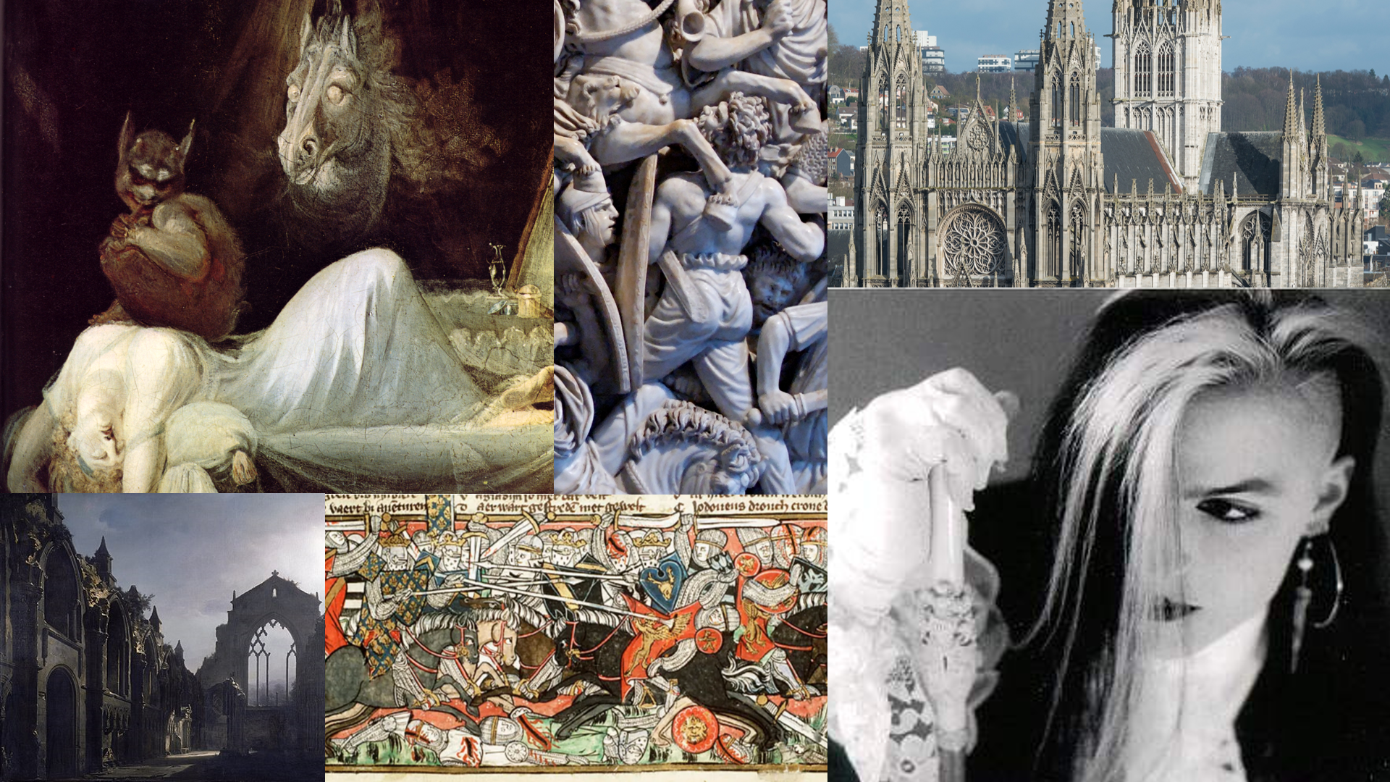

Slide 12
What does ‘Gothic’ mean?

