Slide 1
Some challenges to learn English for Spanish speakers
Prof. Jorge Carroza

Slide 2
Native speakers Vs Non-native speakers of English
743 M
378 M

Slide 3
What seems to be the problem?
1) Sounds ≠ letters

Slide 5
English vowels chart

Slide 6
Spanish vowels chart

Slide 7
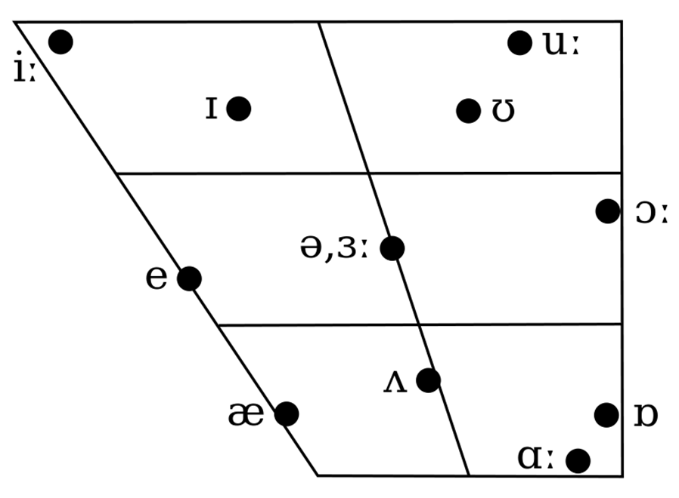

Slide 8
https://www.englishclub.com/pronunciation/phonemic-chart-ia.htm

Slide 10
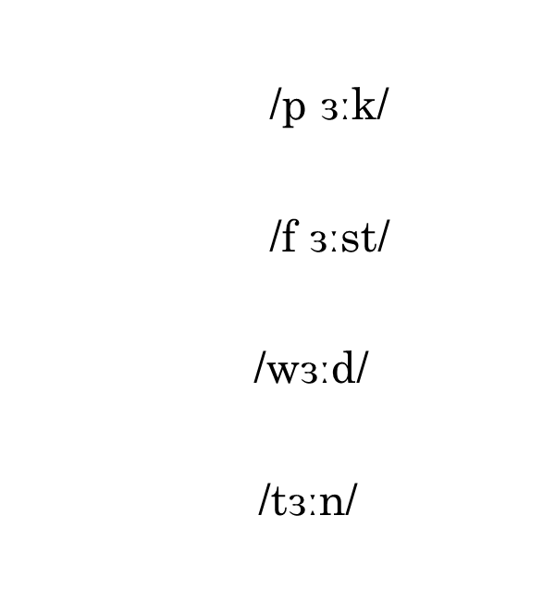
The sound /ɜː/ may be represented with different letters:
-er (perk)
-ir (first)
-or (word)
-ur (turn)

Slide 11
Exercise
The worst word in the world is the word work.
She stirs the soup in her fur coat.
He heard her cry when she burned her hand and hurt herself.
First, turn and look at the birds.

Slide 12
What about consonants?
-ch
/ʧ/ “choose”
/ʃ/ “machine”
/k/ “school”

Slide 13
What seems to be the problem?
2) Silent Letters

Slide 14
Mark the letter out
Logically
Sandwich
Chocolate
Doubt
Would
Logically
Sandwich
Chocolate
Doubt
Would
https://www.youtube.com/watch?v=nUccn2K0fjw&t=54s&ab_channel=mmmEnglish

Slide 15
What seems to be the problem?
3) Links

Slide 16
Links
A: What do you do?
B: I'm ͜ an ͜ engineer / I'm ͜ an ͜ architect

Slide 17
Check this material
https://www.oxfordonlineenglish.com/linking-pronunciation

Slide 18
Remember:
1) Sounds ≠ Letters
2) Silent Letters
3) Links

