Slide 1

Comunidad de Indagación Community of Inquiry
Eduardo Hamuy Pinto
Mag. Educ. / Mención Informática Educativa

Slide 2
Introducción

Slide 3




Background
Teachers
Students
Content
Teaching Presence
Social Presence
Cognitive Presence
Community of Inquiry
(Garrison & Anderson, 2005, 2010; Bustos, Coll, & Engel, 2009; Coll, De Gispert, & Rochera, 2010;
eLC, 2011; Kress, 2009)
Time factor

Slide 4
Presencia Docente
¿Qué implica?
  Dimensiones
  Indicadores

Slide 5
Presencia Social
¿Qué implica?
  Dimensiones
  Indicadores

Slide 6
Presencia Cognitiva
¿Qué implica?
  Dimensiones
  Indicadores

Slide 7
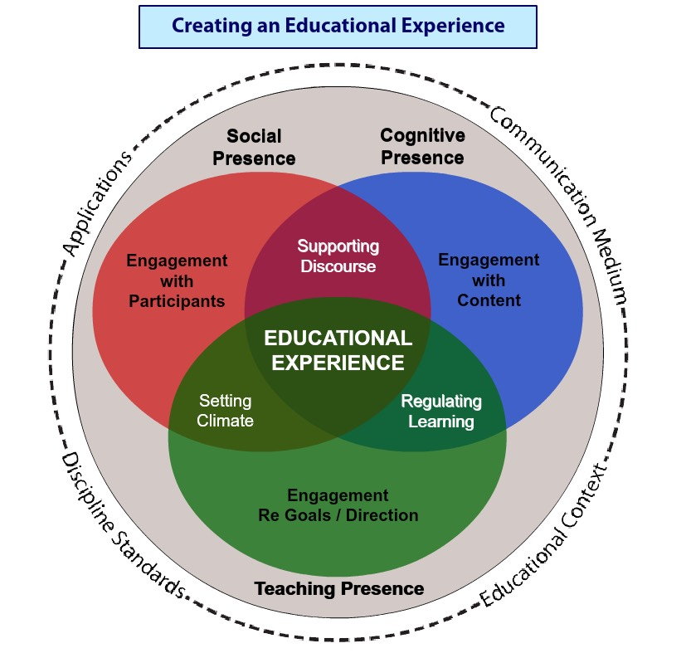
Componentes del modelo conceptual actualizado [hipertexto]

Slide 8
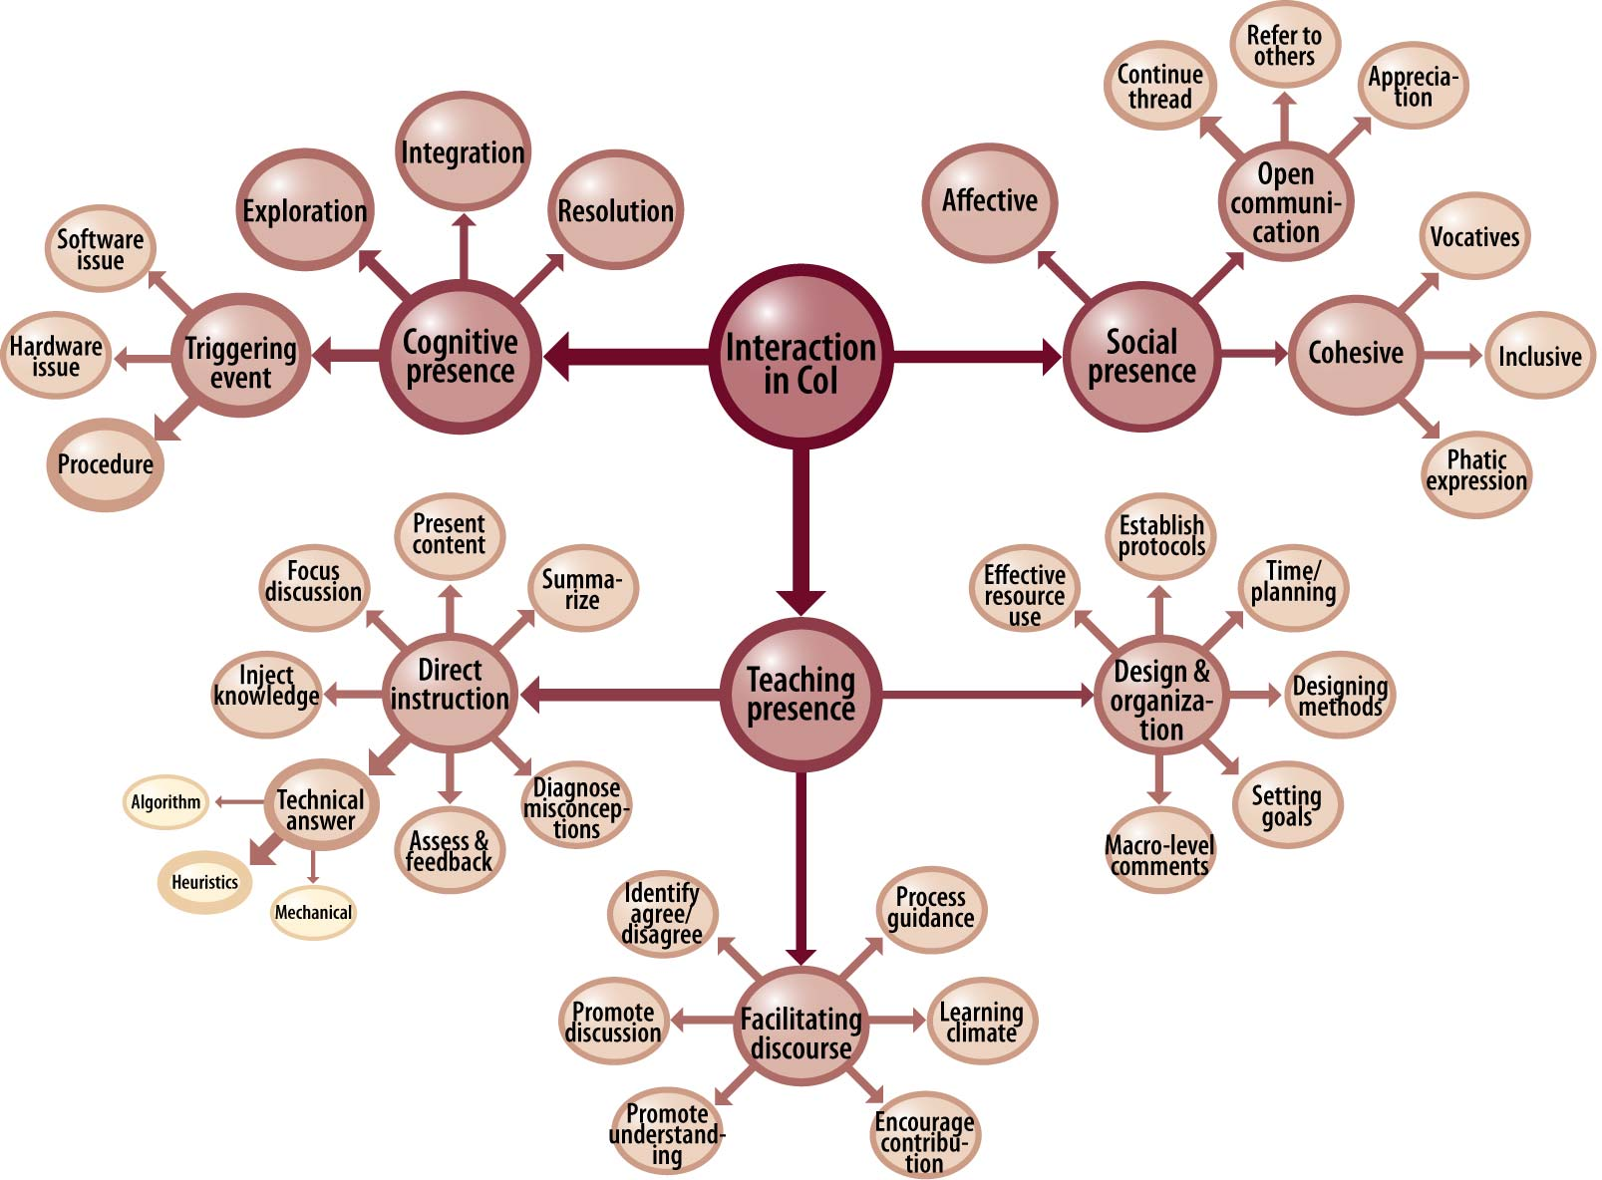
Ejemplo

Slide 9
Impacto de la CoI
Portal de la Community of Inquiry (CoI), alojado en la Athabasca University,
  https://coi.athabascau.ca/
  Recursos bibliográficos, Red de investigadores, Foros, etc.
  Impacto de la CoI (17 enero 2014)
  Google Scholar exhibe 2.002 referencias al trabajo seminal de Garrison, Anderson y Archer (2000). Critical inquiry in a text-based environment: computer conferencing in higher education. Internet and Higher Education, 11/2, 1–14.
  El que 263 trabajos sean exclusivamente del 2013, es un indicador de la vigencia del modelo desde su aparición y a pesar de los cambios tecnológicos.

Slide 10
Revisión de la Literatura
Metodologías para un análisis crítico de la teoría

Slide 11
Técnicas alternativas (que pueden complementarse)
Revisiones Sistemáticas
Metaanálisis
Permite sintetizar el corpus de investigaciones existentes en torno a una problemática.
Aporta rigor a la comparación de resultados entre diferentes estudios.
Una técnica cualitativa, que consiste en el proceso de identificar sistemáticamente y evaluar varios estudios del mismo tipo y con un objetivo común.
Permite sintetizar el corpus de investigaciones existentes en torno a una problemática
Aporta rigor a la comparación de resultados entre diferentes estudios.
Una técnica cuantitativa, aplica un conjunto de técnicas estadísticas que permiten combinar los resultados de diferentes estudios.

Slide 12
Revisión Sistemática
Objetivo de la revisión:
  Valorar el estado de la cuestión sobre las relaciones entre la Presencia Docente y la Presencia Cognitiva.
  Valorar las diferentes formas de abordaje metodológico que se han utilizado para su estudio.
Criterios de inclusión/exclusión de los artículos:
  Que sean listados por Google Scholar o Integrador Base de Datos a partir de los descriptores Presencia Docente + Presencia Cognitiva (castellano o inglés).
Procedimiento
  Identificación:
    Referencia APA
    Keywords del artículo
    Resumen hasta 50 palabras que contextualice el foco del estudio
    Impacto: número de referencias en Scopus o Google Scholar (fecha consulta)
  Análisis conceptual:
    Definición Presencia Docente
    Definición Presencia Cognitiva
    Relación teórica que otorga entre ambas
  Análisis metodológico:
    Muestra y contexto del estudio
    Técnicas usadas para levantar datos y analizarlos
  Resultados obtenidos

Slide 13
Corpus
 | Artículos
A | Garrison, D. R., & Arbaugh, J. B. (2007). Researching the community of inquiry framework: Review, issues, and future directions. The Internet and Higher Education, 10(3), 157–172. doi:10.1016/j.iheduc.2007.04.001
B | Garrison, D. R., Anderson, T., & Archer, W. (2010). The first decade of the community of inquiry framework: A retrospective. The Internet and Higher Education, 13(1-2), 5–9. doi:10.1016/j.iheduc.2009.10.003
1 | Ke, F. (2010). Examining online teaching, cognitive, and social presence for adult students. Computers & Education, 55(2), 808–820. doi:10.1016/j.compedu.2010.03.013
2 | Akyol, Z., & Garrison, D. R. (2011). Assessing metacognition in an online community of inquiry. The Internet and Higher Education, 14(3), 183–190. doi:10.1016/j.iheduc.2011.01.005
3 | Joo, Y. J., Lim, K. Y., & Kim, E. K. (2011). Online university students’ satisfaction and persistence: Examining perceived level of presence, usefulness and ease of use as predictors in a structural model. Computers & Education, 57(2), 1654–1664. doi:10.1016/j.compedu.2011.02.008
4 | Carlon, S., Bennett-Woods, D., Berg, B., Claywell, L., LeDuc, K., Marcisz, N., … Zenoni, L. (2012). The community of inquiry instrument: Validation and results in online health care disciplines. Computers & Education, 59(2), 215–221. doi:10.1016/j.compedu.2012.01.004
5 | Arbaugh, J. B. (2013). Does academic discipline moderate CoI-course outcomes relationships in online MBA courses? The Internet and Higher Education, 17, 16–28. doi:10.1016/j.iheduc.2012.10.002
6 | Stein, D. S., Wanstreet, C. E., Slagle, P., Trinko, L. a., & Lutz, M. (2013). From “hello” to higher-order thinking: The effect of coaching and feedback on online chats. The Internet and Higher Education, 16, 78–84. doi:10.1016/j.iheduc.2012.03.001
7 | Garrison, D. R., & Akyol, Z. (2013). Toward the development of a metacognition construct for communities of inquiry. The Internet and Higher Education, 17, 84–89. doi:10.1016/j.iheduc.2012.11.005
8 | Kozan, K., & Richardson, J. C. (2014). Interrelationships between and among social, teaching, and cognitive presence. The Internet and Higher Education, 21, 68–73. doi:10.1016/j.iheduc.2013.10.007

Slide 14
Ejemplo de Revisión Sistemática aplicada a la CoI
Reference | Theoretical Background
Rourke, L., & Kanuka, H. (2009). Learning in Communities of Inquiry: A Review of the Literature. Journal of Distance Education, 23(1), 19–48. | CP: Cognitive presence is understood as the extent to which participants are able to construct meaning through sustained communication. | C+T: The approach taken by this study examines exclusively the relationship between CoI literature and evidences of meaningful learning, thus it does not analyze particular interaction between CP and TP.
This research focuses on a deep critical review of the assertions and evidence provided by research literature for one of CoI framework’s central claims in Garrison et al. (1999, 2000) seminal work, mainly that in an educational environment where the three dimensions described by this framework are fully present, these can account for deep meaningful learning. 122 citations in Google Scholar (as of 7/18/14) |  | TP: Teaching presence is understood as the responsibilities of the instructor expressed through the areas of design, facilitation and direct instruction.

Slide 15
Method
Literature review with multivocal approach (Ogawa & Malen, 1991), analyzing mixes of quantitative and qualitative studies and for which they adapted exploratory study case (Gall, Gall & Borg, 2006). Method is described in eight steps: defining focus; searching the relevant literature in three academic databases; using Google Scholar to identify the keystone articles and the 235 articles that referenced them; classifying these articles by reviewing their abstracts, categorizing them as theoretical, review, or empirical, and identifying the 48 that contained empirical evidence on student learning; building a summary database; identifying the conceptual constructs present, that is meaningful learning (dependent variable) solely on the basis of learning outcomes not processes, and TP, SP and CP (independent variables); comparing the empirical evidence on students’ meaningful learning in CoI studies with other studies on the subject; discussing the results of this literature review with peers, most significantly with progenitors of CoI, and requesting their expert evaluation and suggestions.

Slide 16
Results
Focus of studies: CP (26), SP (24), TP (23), Learning (5). 48 studies are empirical, 5 theoretical, 2 review. Those studies that specifically probed Learning, their evidence relies 1st solely on students’ perceptions 2nd even on those grounds, they acknowledge lower-order cognitive skills rather than higher-order as meaningful learning implies. Literature on Learning referenced in the article discusses to what extent self-reports on learning may not be fully reliable measure for learning (with a medium correlation with learning outcomes). Survey instrument used for self-reports is suspected to contain ambiguous items, insufficient to coherently represent the construct —learning— that the framework builds on. CoI framework has failed as a program of research and as an e-learning model. They argue in favor of the greater reliability of other instruments that the literature on learning research favors, such as Concept-Mapping and Test Blueprinting. CP has been overstated in most studies, since it should comprise the four phases of critical inquiry and yet 50% of the coding is for exploration, 20% is for integration, 10% for triggering events (puzzlement) and only 5% for resolution. In this statement Rourke and Kanuka (2009) are not sufficiently clear, where the problem would exactly rest. Finally they argue that CoI is unable to engender deep and meaningful learning on theoretical grounds, putting forth other authors that assert that this can occur only if there is student assessment, reduction of content and confrontation of misconceptions. These, they argue rarely occur in sufficient degrees in e-learning practices.
Notes:
----- Notas de la reunión (04-05-15 19:29) -----
¿Qué pasa con el 15% restante en la P Cognitiva?

