Slide 1
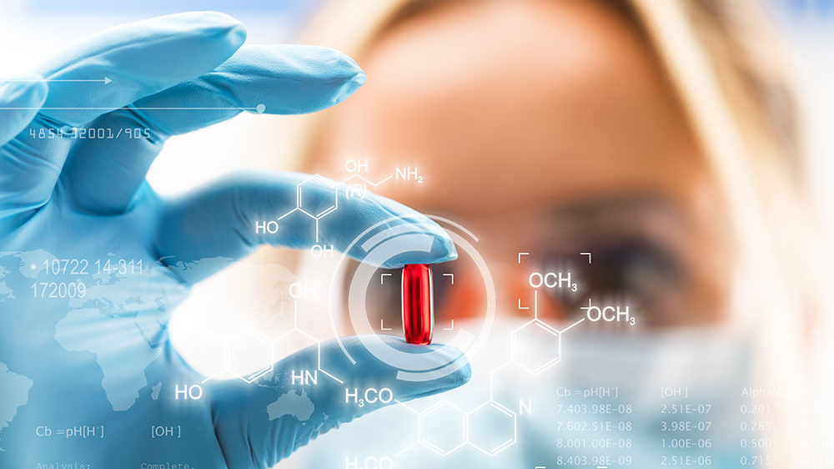
QUÍMICA MEDICINAL
2
INTERACCIÓN
FÁRMACO-RECEPTOR

Slide 2
INTRODUCTION
“Drug is any substance or product that is used or is intended to be used to modify or explore physiological systems or
pathological states for the benefit of the recipient” WHO 1966
“Receptor is a macromolecule in the membrane or inside the cell that specifically (chemically) bind a ligand (drug). The binding of a drug to receptor depends on types of chemical bonds that can be established between drug and receptor. The strength of this chemical bonds (covalent, ionic, hydrogen, hydrophobic) determine the degree of affinity of ligand to receptor.”

Slide 3
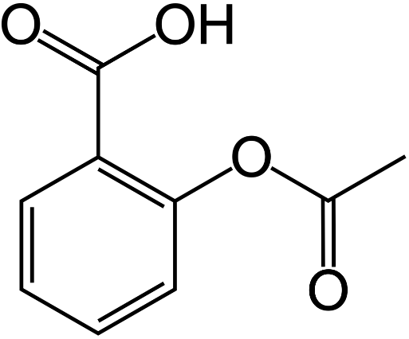
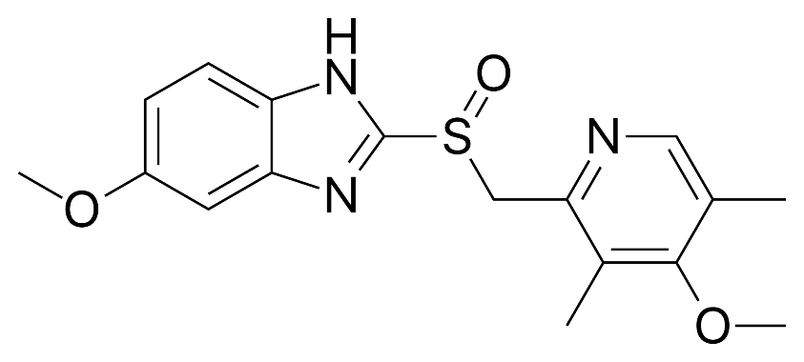
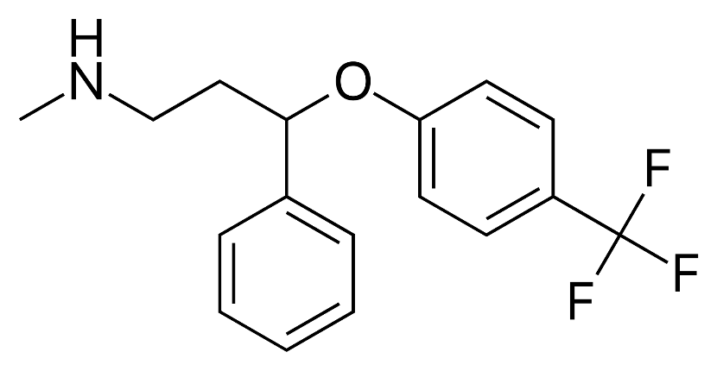
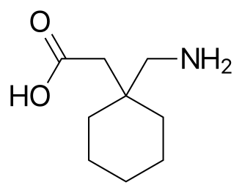
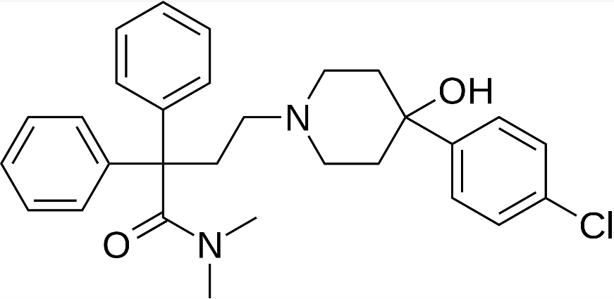
Most drugs are molecules, but most molecules are not drugs.
Omeprazole
Specific H+/K+ATPase inhibitor
Prozac® / Fluoxetin
SSRI
Aspirin® / ASA
COX inactivation
Gabapentin
α₂δ subunit-containing VDCCs inhibitor
Loperamide
Opioid receptor agonist

Slide 4
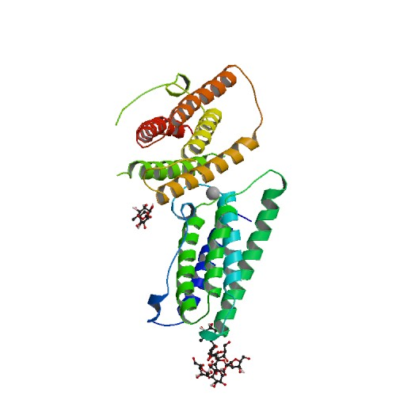
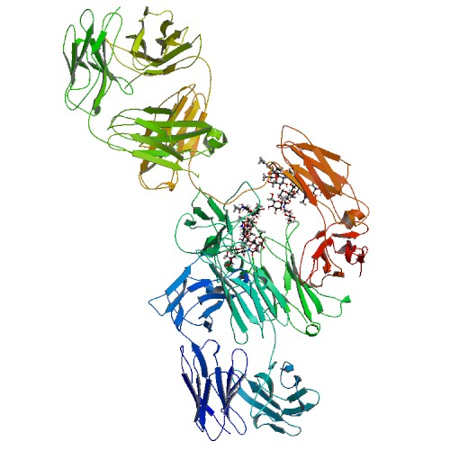
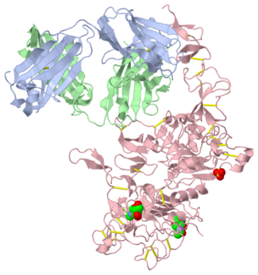
Also drugs…
Adalimumab
TNF inhibitor
(autoimmune disorders)
Herceptin
Breast cancer
Interferon beta A1
Anti-inflammatory
(MS)
Drug activity is given by its chemical structure

Slide 5
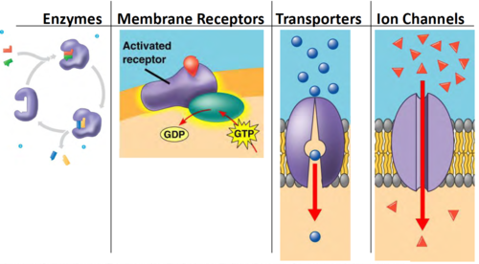
MAIN TARGETS FOR DRUG BINDING
MAIN TARGETS FOR DRUG BINDING

Slide 6
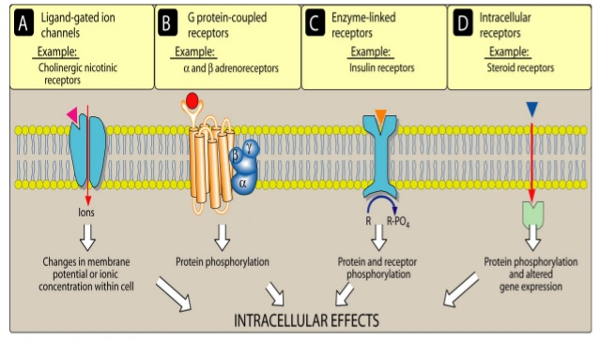
MAJOR RECEPTOR FAMILIES

Slide 7
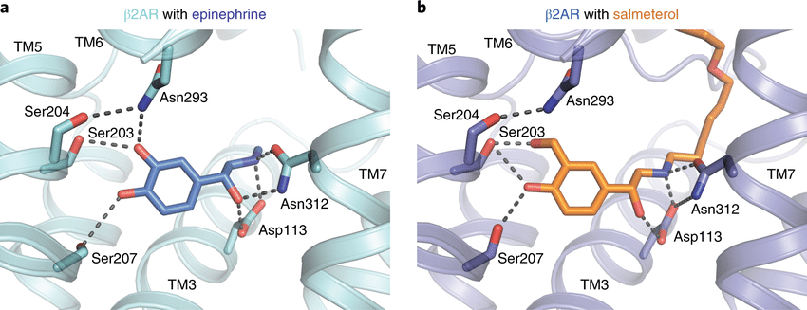
THE CHEMICAL NATURE OF THE DRUG-RECEPTOR BINDING
π-π stacking
bonds are formed spontaneously when the ligand reaches the appropriate distance from its receptor

Slide 8
REVERSIBLE BINDING

Slide 9
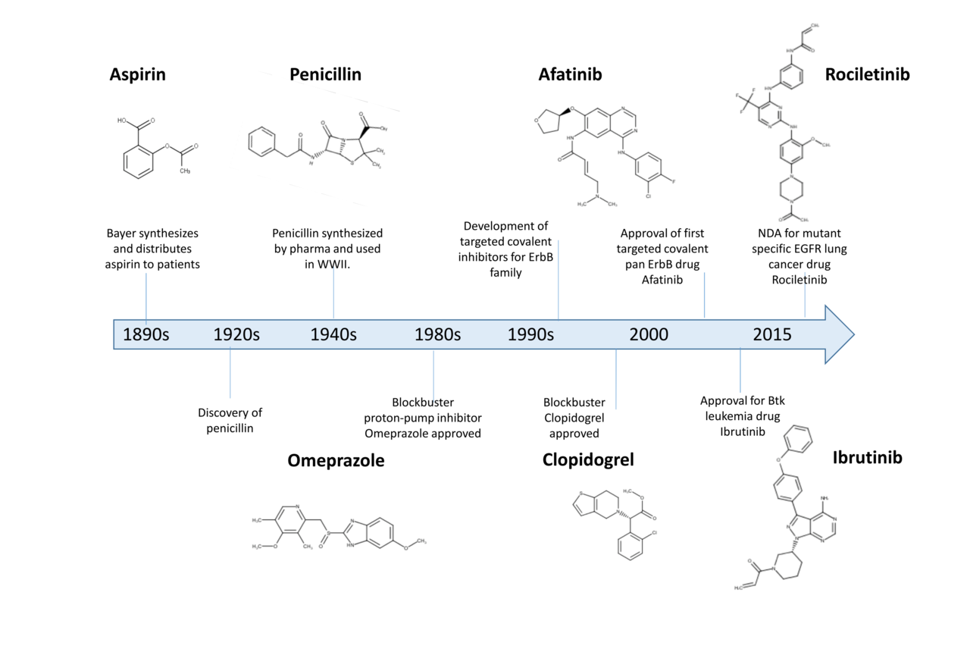
DRUG – RECEPTOR INTERACTIONS
Covalent:
40-140 kcal/mol
- TCI (Targeted covalent inhibitors)
Not common except for enzymes and DNA drugs
High or ‘’essencially infinite’’ potency
Very high selectivity (much les action sites)
Function restoring recquires protein biosynthesis
- Very desiderable in anti-cancer drugs

Slide 10
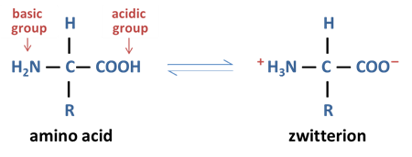
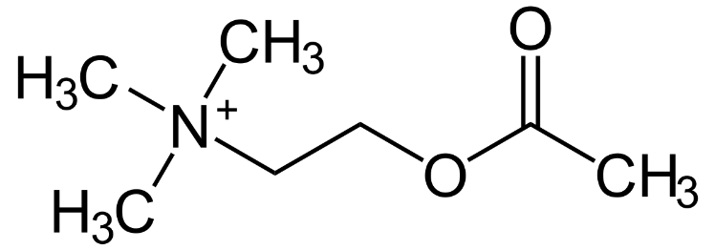
DRUG – RECEPTOR INTERACTIONS
Ionic
5 kcal/mol
- At physiological pH, many groups will be ionizated
- Many drugs are ionic at physiological pH
Ionic bond can happen at higher distances but…
…their strengh is inversely proportional to d²

Slide 11
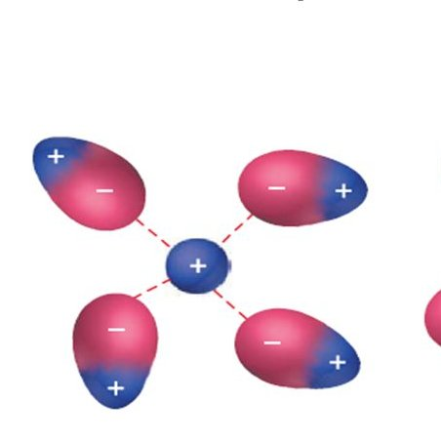
DRUG – RECEPTOR INTERACTIONS
Ion-dipole and dipole-dipole
1-7 kcal mol
- C-X bond displays unsymmetrical electron distribution
- Requires effective alignement
Ion-dipole > dipole-dipole
Also electrostatic
Ion-dipole
Ion-dipole
Dipole-dipole

Slide 12
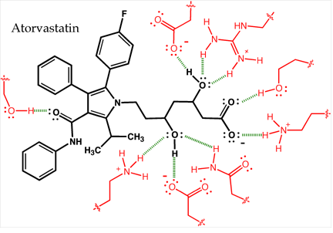
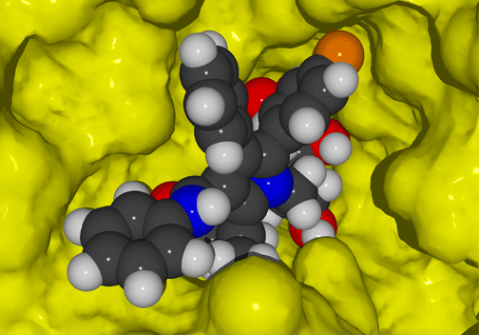
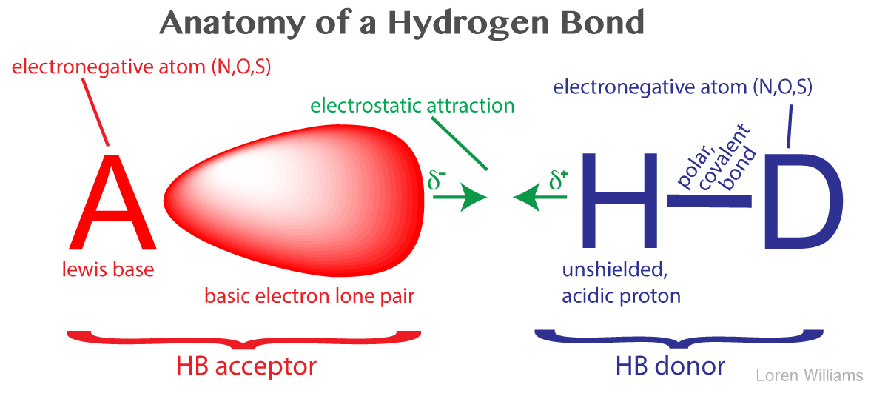
DRUG – RECEPTOR INTERACTIONS
Hydrogen bonding
3-5 kcal/mol
- Intra or intermolecular
Widespread in drug-receptor interactions
Weak but decisive

Slide 13
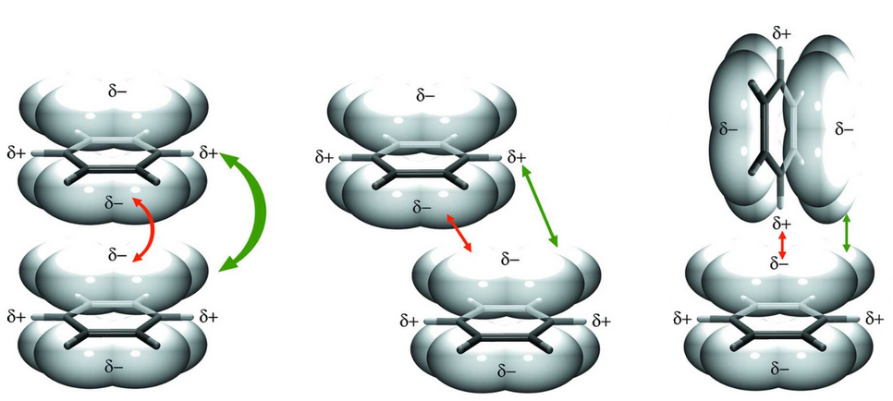
DRUG – RECEPTOR INTERACTIONS
Charge transfer complex
<1 kcal/mol
- An electron-donor molecule (or group) gives charge to an electron
It’s all about orbitals (alkenes, alkynes, aromatics)
Substituents makes the difference
- Donors: Tyr, Asp. Acceptors: Cys, Trp…

Slide 14
DRUG – RECEPTOR INTERACTIONS
Hydrophobic interactions
Very weak interactions
- Entropy-driven event
Free energy release
Usually about sites not entire molecules
Many authors suggest the hydrophobic effect does not even exist
Many others think they are one of the most important factors…

Slide 15
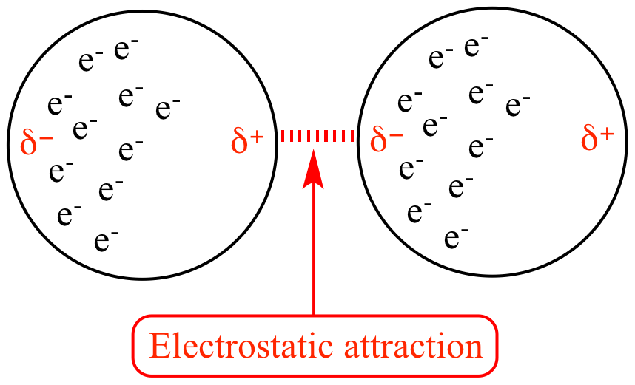
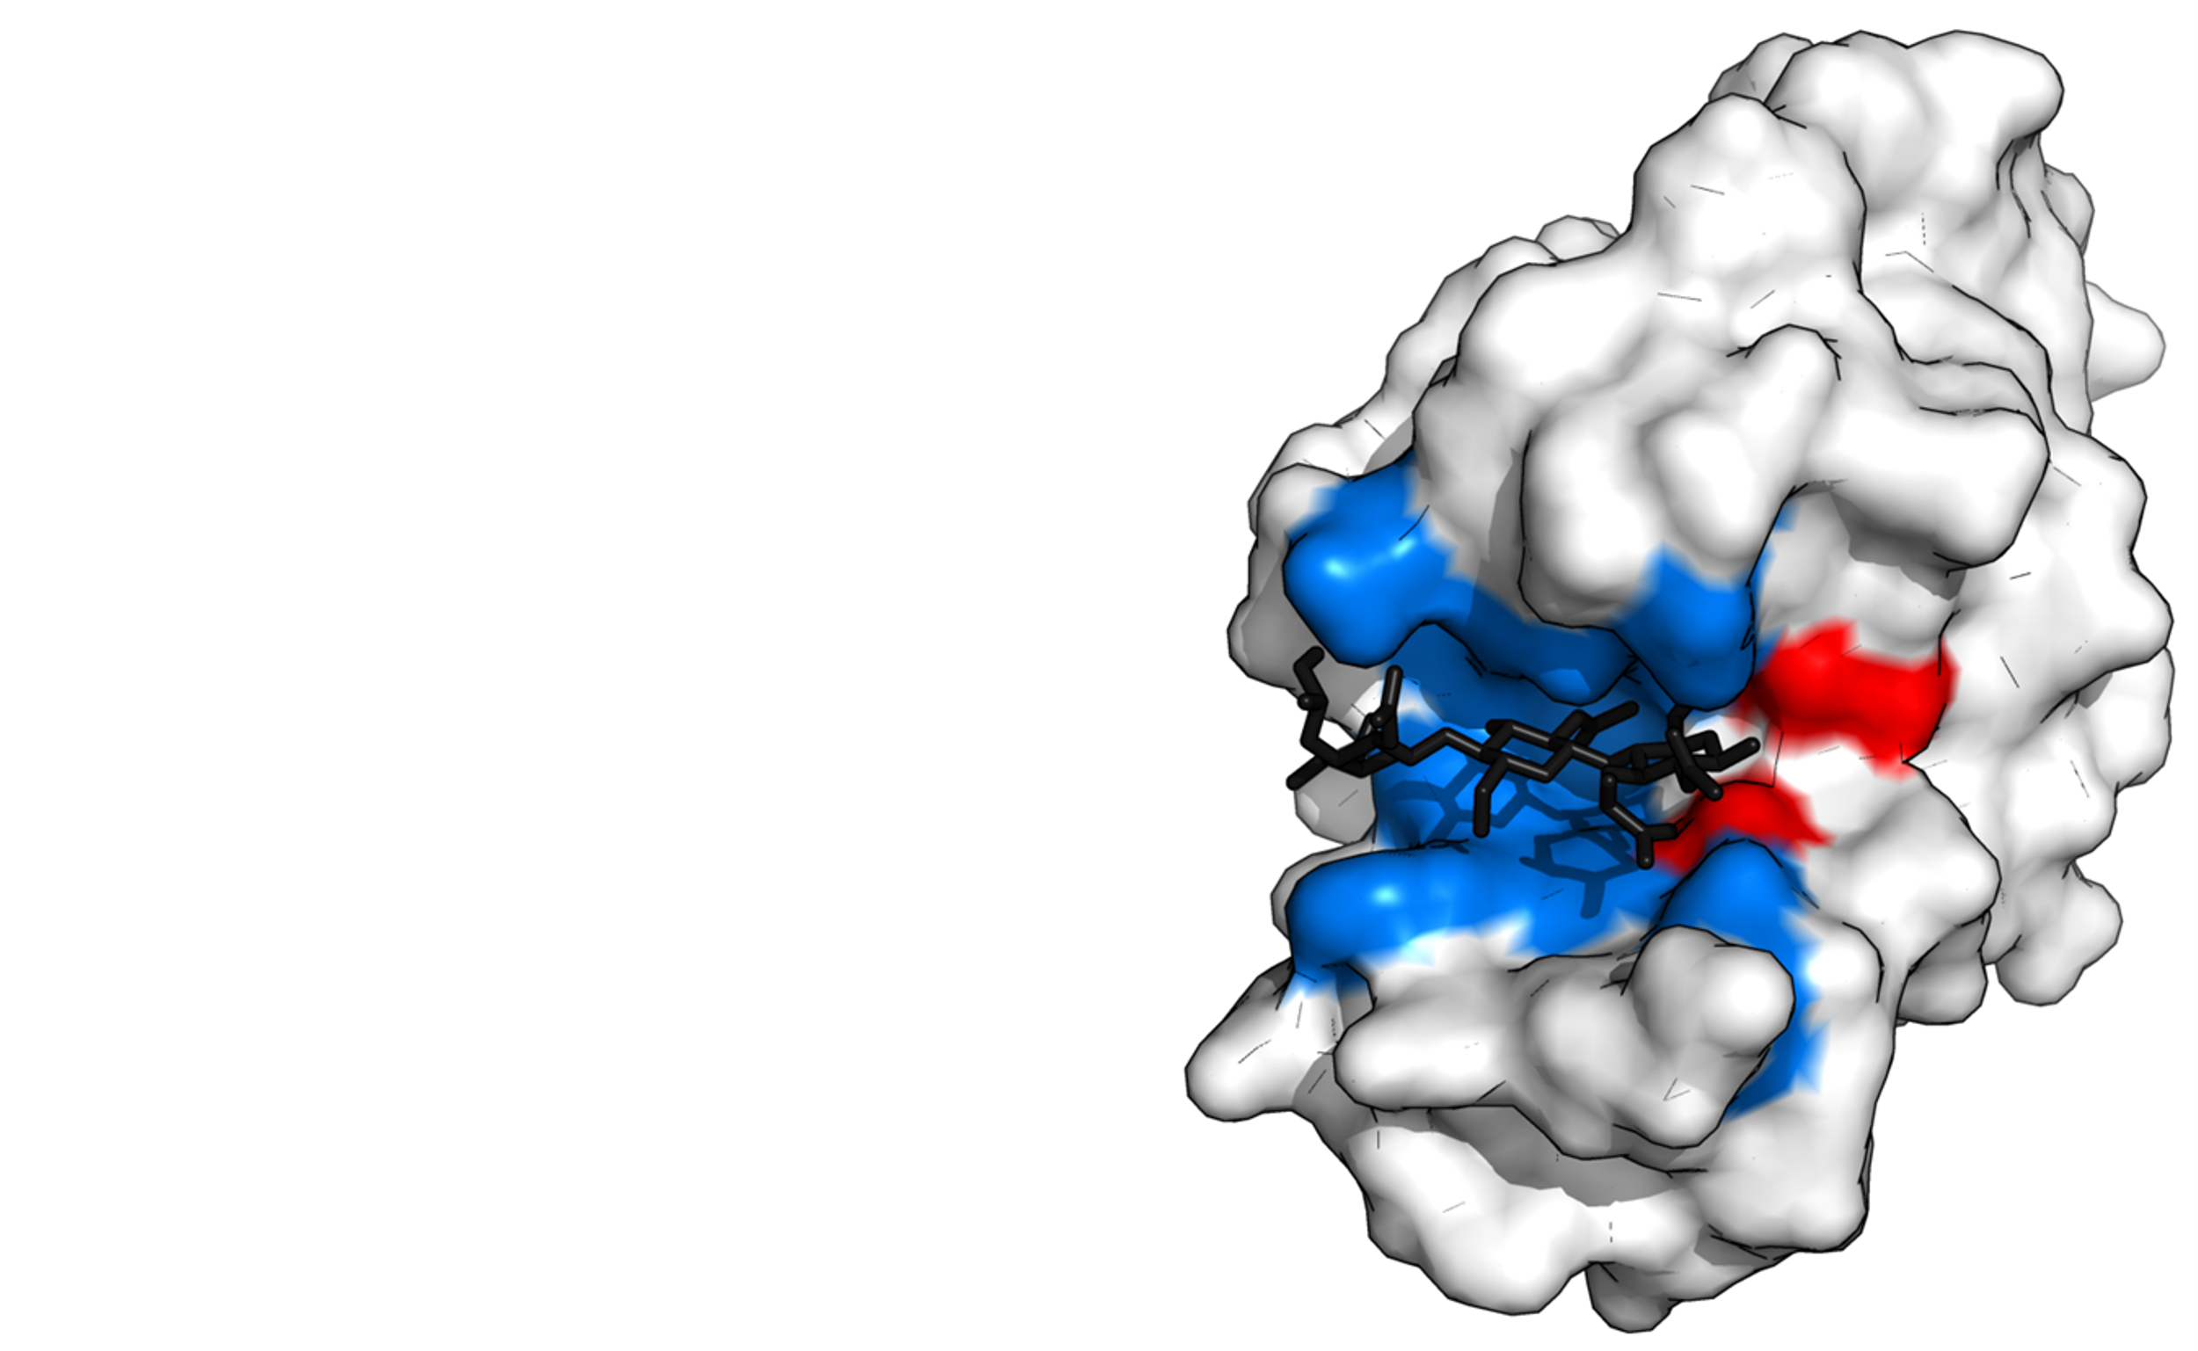
DRUG – RECEPTOR INTERACTIONS
Van der Waals - London
Asymmetric charge distribution in apolar molecules
- Instant dipoles – Instant dipoles
Only significant at short distances but…
…drug-receptor interactions imply molecular fit
0.5 kcal/mol

Slide 16
DRUG – RECEPTOR INTERACTIONS
Halogen bonding
Known for decades but recently applied to rational drug design
- R−X···Y−R′ (X = Lewis acid, Y = donor atom)
Halogens are very common in medicinal chemistry (F, Cl, Br, CF₃, etc)
Halogen acts as Lewis acids and they interact with donors!!
1-2 kcal/mol
Weak but decisive

Slide 17
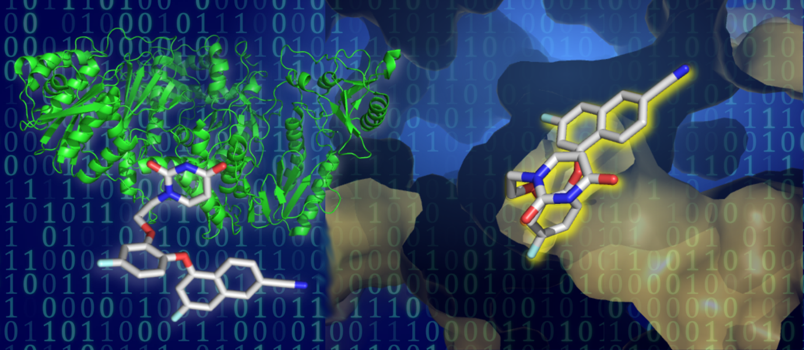
COMPUTER-AIDED DRUG DESIGN

Slide 18
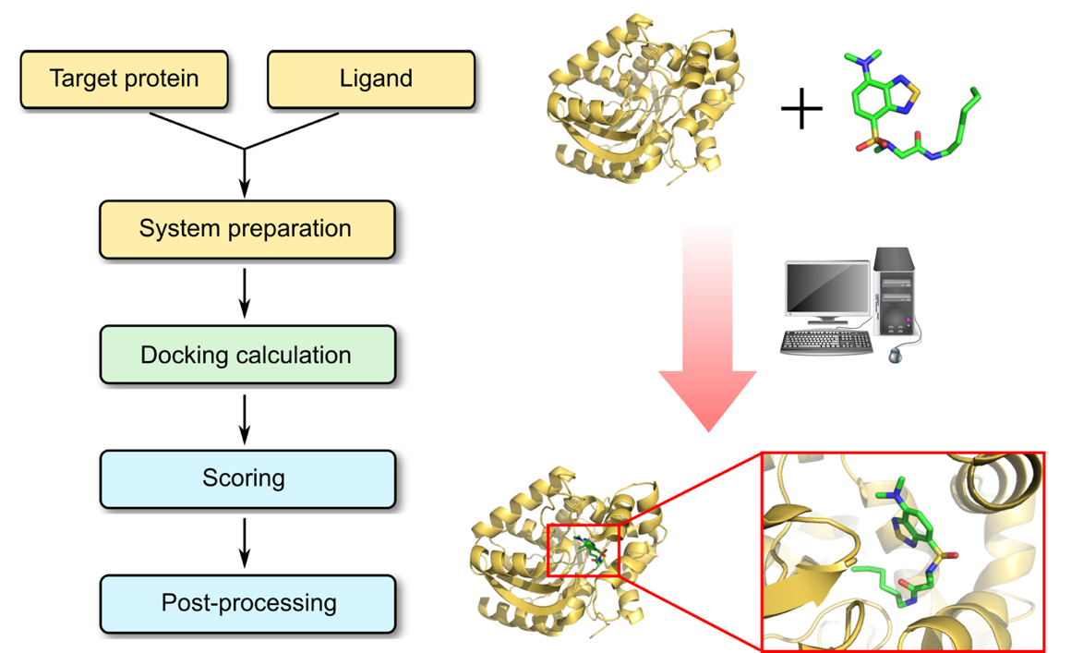
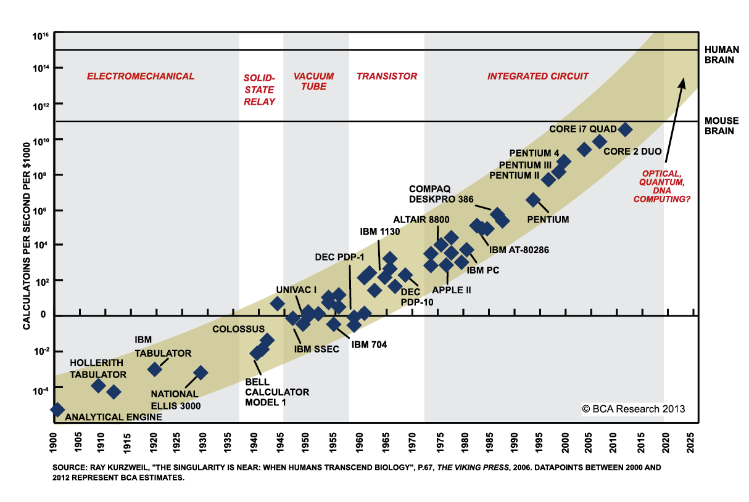
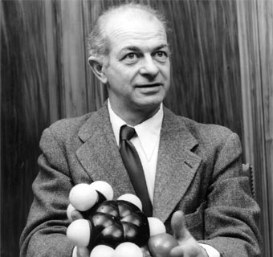
MOLECULAR DOCKING
Moore’s Law
-In silico structure-based method widely used in drug discovery.
-Identification of novel compounds of therapeutic interest
-Predicting ligand-target interactions at a molecular level
-Delineating structure-activity relationships (SAR)
-Evolution of computational chemistry

Slide 19
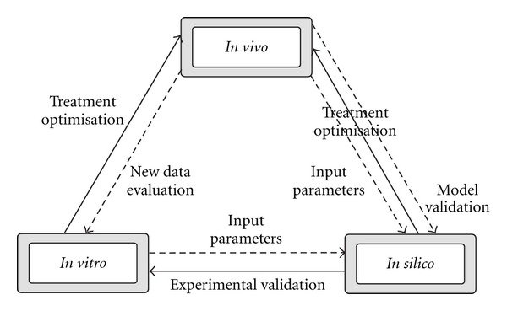
MOLECULAR DOCKING

Slide 20
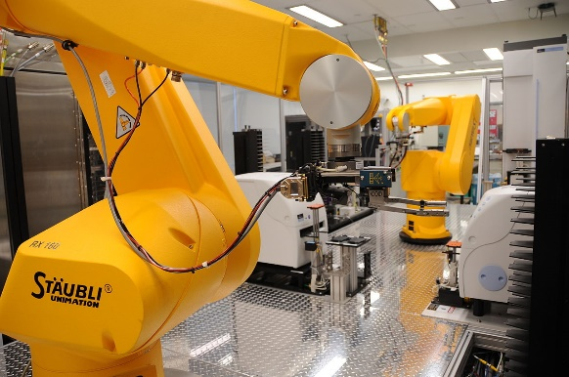
MOLECULAR DOCKING
Medicinal Chemistry
In vitro
In vivo
Drug development…
HTS
High Throughput Screening
Drug Candidates
Chemical structures
Biological data
Computer Technology
Medicinal Chemistry
In vitro
In vivo
Drug development…
Therapeutic targets
Huge data available

Slide 21
‘’Docking is a method which predicts the preferred orientation of one molecule to a second when bound to each other to form a stable complex.’’
SCORING FUNCTION: MATHEMATICAL
FUNCTIONS THAT PREDICT AFFINITY
BETWEEN TWO MOLECULES
Virtual screening of small molecule databases of candidate ligands to identify novel small molecules that bind to a protein target of interest and therefore are useful starting points for drug discovery
De novo design (design "from scratch") of novel small molecules that bind to a protein target
Lead optimization of screening hits to optimize their affinity and selectivity

Slide 23
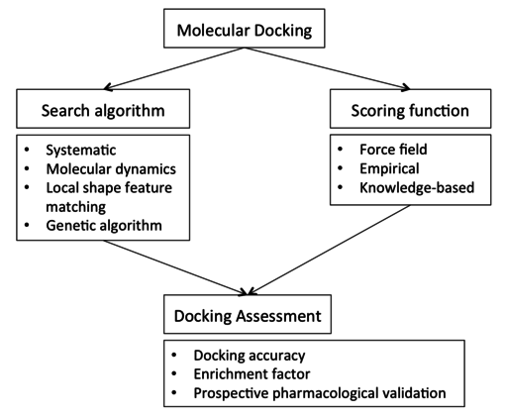
MOLECULAR DOCKING
Magenta dashed lines represent hydrogen bonds
green dashed lines represent aromatic interactions
p-cation interactions are denoted by purple dashed lines

Slide 24
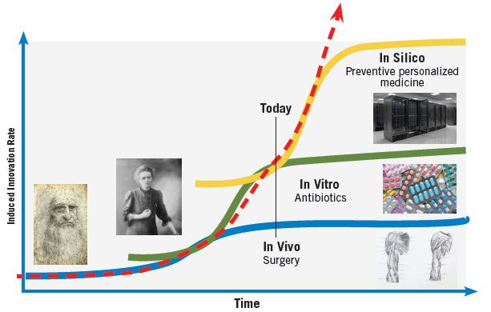
Evolution of experiments in Drug Discovery

Slide 25
HIV 1 Integrase—a new binding site for drugs treating AIDS was discovered by Schames et al. using docking while considering the flexibility of the receptor through molecular dynamics. The group used AutoDock in conjunction with the relaxed-complex method to discover novel mode of inhibition of HIV integrase

