Slide 1
Equality Partners
Members:
Oscar Valenzuela R.
Ignacio Vargas M.

Slide 2
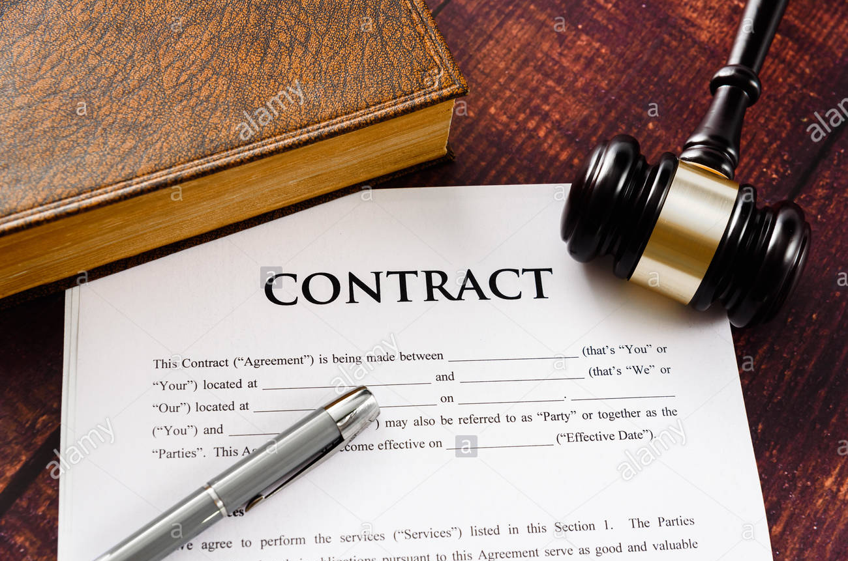
Introduction
What it is ?
Characteristics
Advantage and disadvantage
Examples in the real life
Conclusión and personal opinion.

Slide 3
What it is an equality partner?
In general is: a partner who receives a share of the partnership profits and has the right to take part in the management of the partnership.
Being an equity partner means that a partner buys into the business, in order the receive a cut of the business's profits later on.

Slide 4
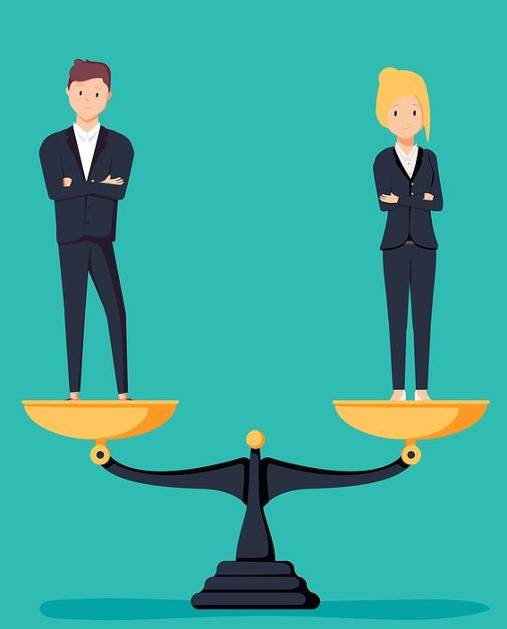
About the characteristic
- We can mention three main characteristics: The first is about the partner, due to each partner could participate in the management and all they contribute initial capital and share de profit and losses.
- Other characteristics we can mention this type of society is the general rule in new partnerships, in the official newspaper we can find every day like 10 cases.
- And finally, the equality partners is the most older society in the world, because the first evidence or sign is in Rome with the collective society establish in article 350 to 423 CMM

Slide 5
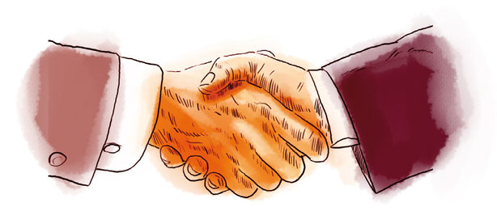
Advantage and Disadvantage
Advantage:
1-. Profits are distributed equally amongst partners.
2-. Have full voting rights on important decisions about the future of the business.
3-. The potential to grow their salary relatively quickly.
Disadvantage:
1-. Disputes in decision making.
2-. Competing interests.
3-. Is being liable for the debts of the partnership

Slide 6
Some examples in the real life
In the real life we can find:
-Casas Chile SRL.
-HumanNet Ltda.
- Servicios de tecnología computacional Raul Arturo Pérez Vega y compañia limitada
- Educación extraescolar JAPII

Slide 7
Conclusion
In general, equality partner is a very important institution for world trade, it is of utmost importance since it makes it easier to create companies between people who want to compete for common purposes.
Personal opinion:
> Oscar: Warning! Check your capital.
>Ignacio: Believe in you and in your peer.

